Slide 1
My Comfort
“He was pierced for our sins, He was crushed for our wrongdoings; the punishment that brought us peace was on Him, and by His wounds we are healed.” ~Isaiah 53:5

Slide 2
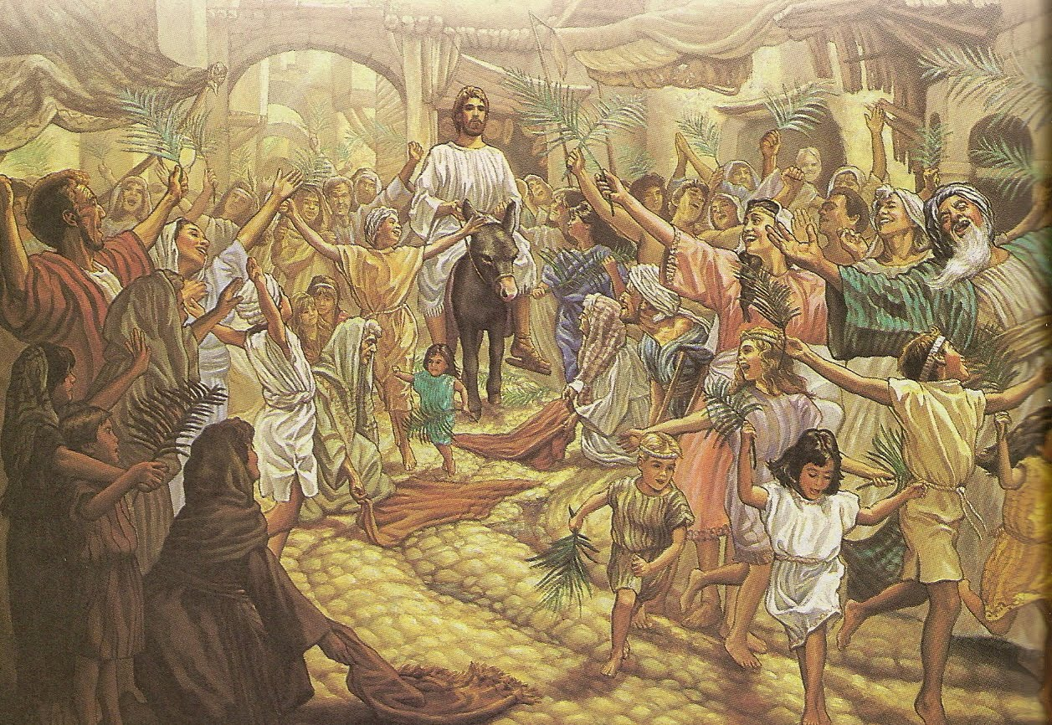

Slide 3
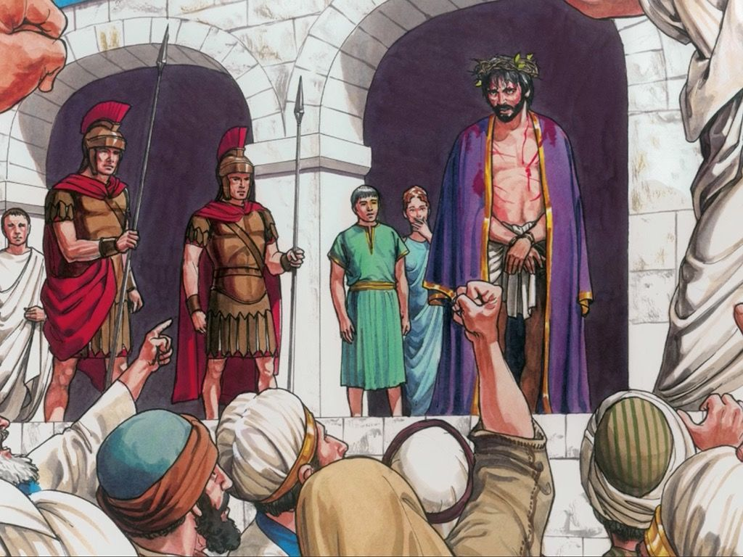

Slide 4
⁴¹ As Jesus came to the city and observed it, He wept over it. ⁴² He said, “If only you knew on this of all days the things that lead to peace. But now they are hidden from your eyes. . . . You didn’t recognize the time of God’s coming to you.” ~Luke 19:41-44

Slide 5
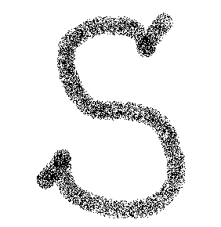
See Jesus as Suffering Servant
My Comfort

Slide 6
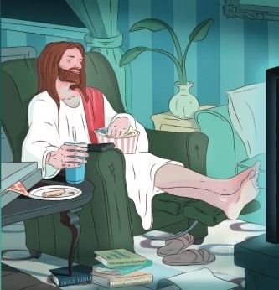

Slide 7
Surrender Our Comfort
My Comfort

Slide 8
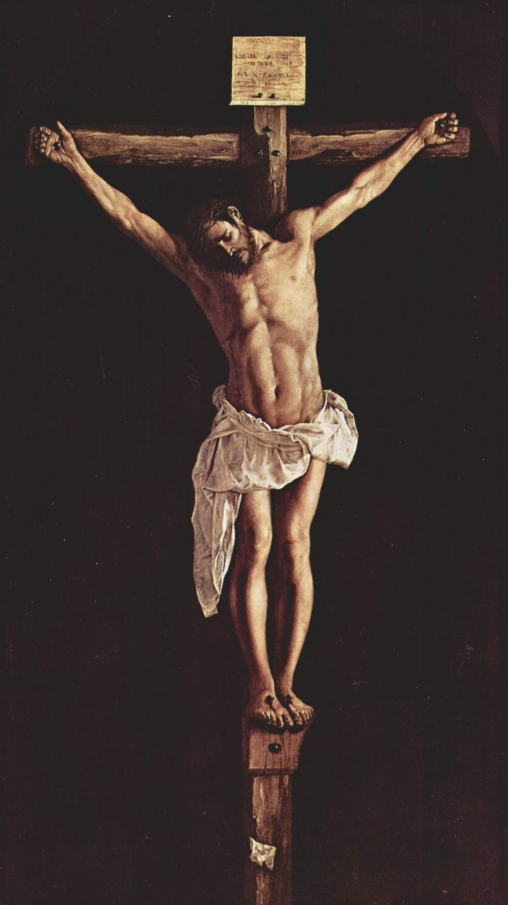

Slide 9
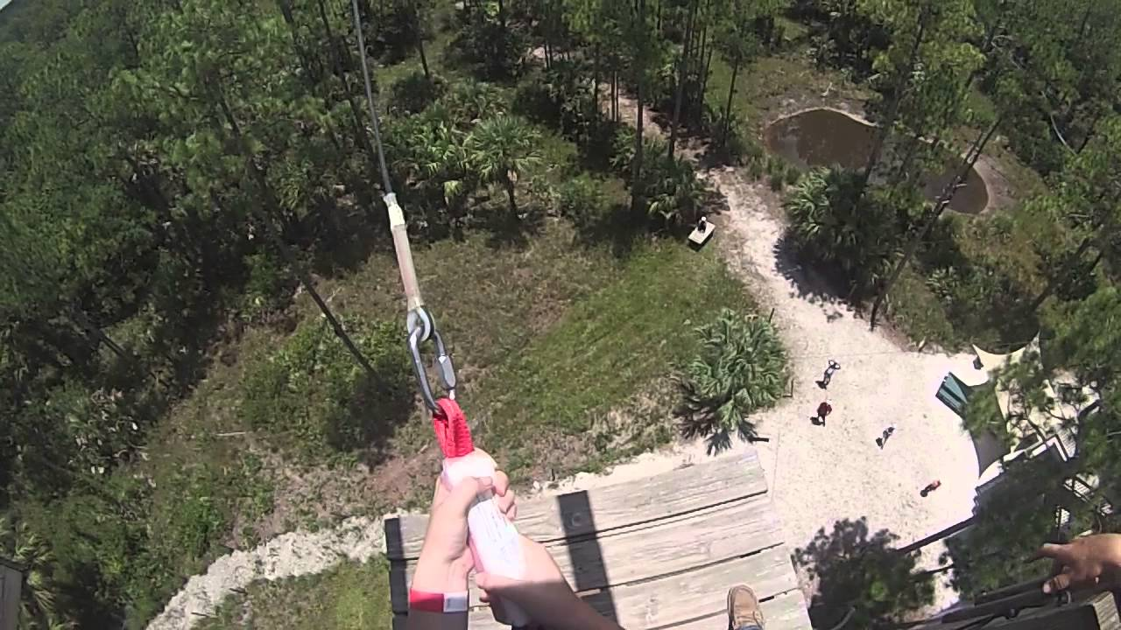

Slide 10
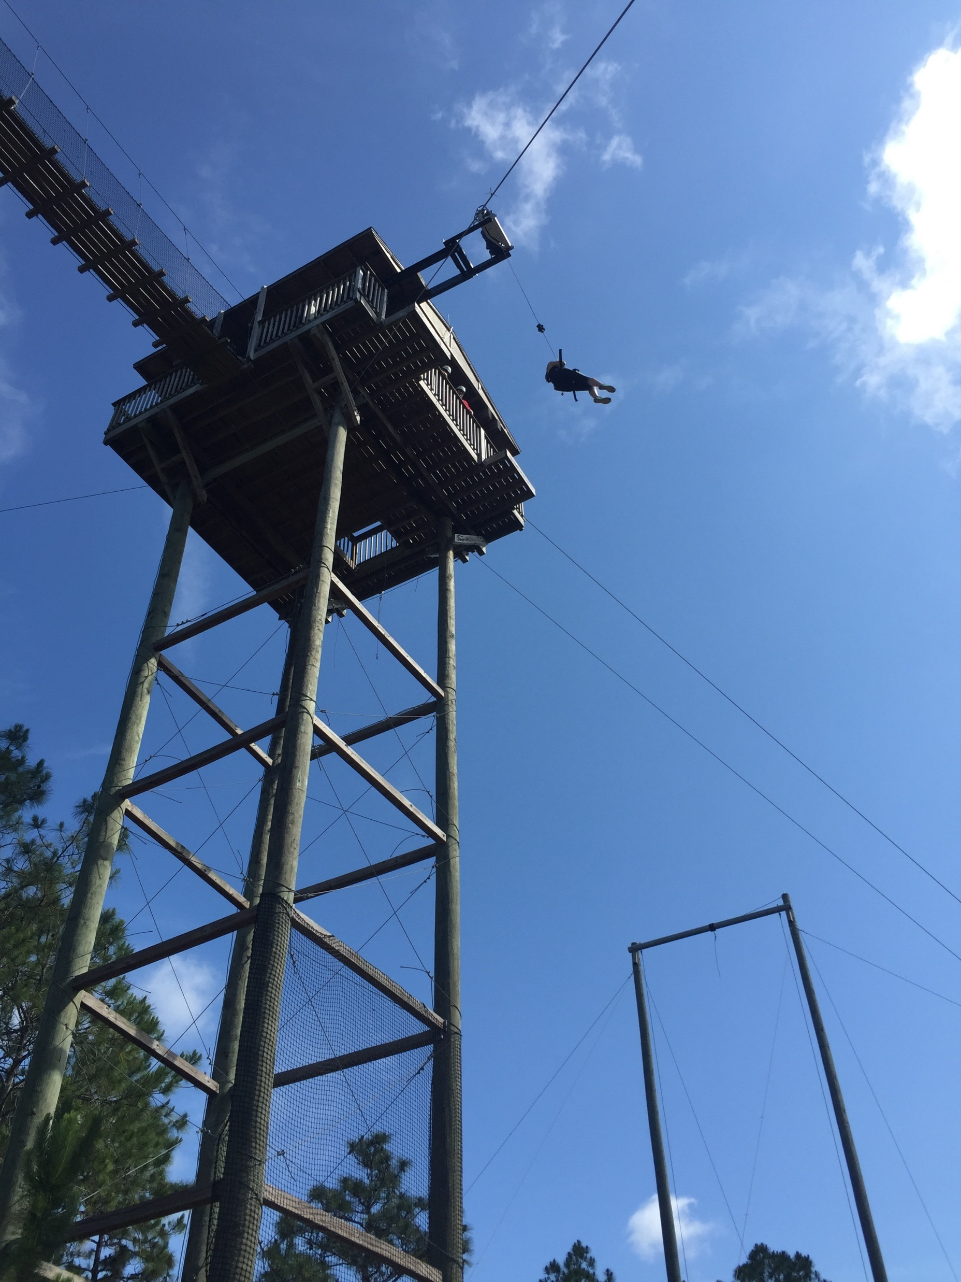

Slide 11
Seek the Greater Blessing
My Comfort

Slide 12
