Slide 1

ANXIETY
“Throw all your anxiety onto Him every day, because you know how He cares about you.” ~ Peter 5:7

Slide 2
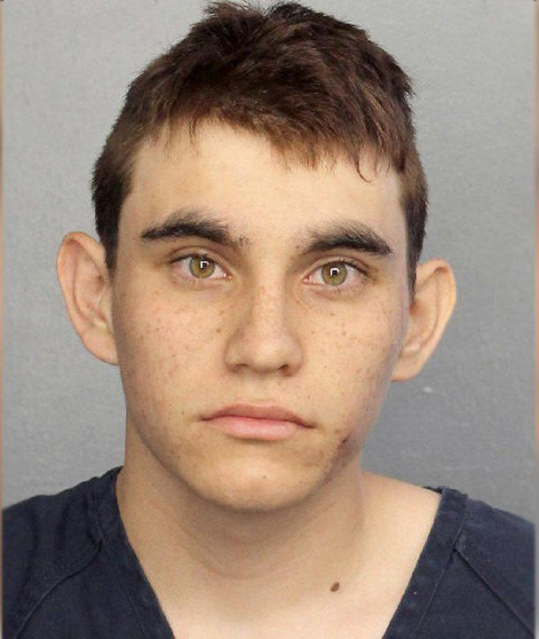
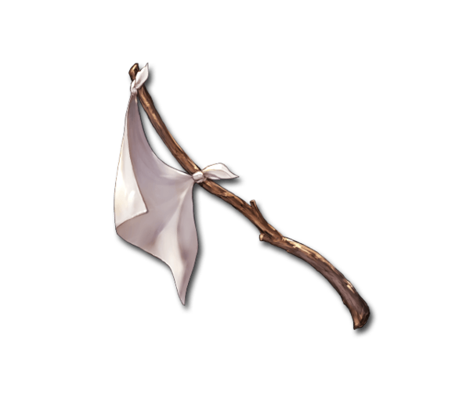

Slide 3
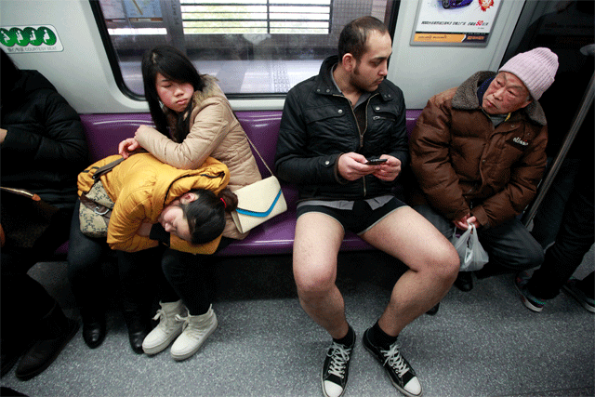

Slide 4


Slide 5
Isaiah 41:10 “Do not fear [declares the Lord], for I am with you; Do not anxiously look about you, for I am your God. I will strengthen you, surely I will help you, surely I will uphold you with My righteous right hand.”
  Psalm 27:1 “The Lord is my light and my salvation; whom shall I fear? The LORD is the defense of my life; whom shall I dread?”
    Psalm 23:4 “Even though I walk through the valley of the shadow of death, I fear no evil, for You are with me; Your rod and Your staff, they comfort me.”

Slide 6

Jesus said, “Peace I leave with you;
My peace I give to you; not as the world gives do I give to you. Do not let your heart be troubled, nor let it be fearful.” ~ John 14:27

Slide 7



Slide 8
Matthew 6:25‑34 (CEB)
²⁵ “Therefore, I say to you, don’t worry about your life, what you’ll eat or what you’ll drink, or about your body, what you’ll wear. Isn’t life more than food and the body more than clothes? ²⁶ Look at the birds in the sky. They don’t sow seed or harvest grain or gather crops into barns. Yet your heavenly Father feeds them. Aren’t you worth much more than they are? ²⁷ Who among you by worrying can add a single moment to your life? ²⁸ And why do you worry about clothes? Notice how the lilies in the field grow. They don’t wear themselves out with work, and they don’t spin cloth. ²⁹ But I say to you that even Solomon in all of his splendor wasn’t dressed like one of these.

Slide 9
Matthew 6:25‑34 (CEB)
³⁰ If God dresses grass in the field so beautifully, even though it’s alive today and tomorrow it’s thrown into the furnace, won’t God do much more for you, you people of weak faith? ³¹ Therefore, don’t worry and say, ‘What are we going to eat?’ or ‘What are we going to drink?’ or ‘What are we going to wear?’ ³² Gentiles long for all these things. Your heavenly Father knows that you need them. ³³ Instead, desire first and foremost God’s kingdom and God’s righteousness, and all these things will be given to you as well. ³⁴ Therefore, stop worrying about tomorrow, because tomorrow will worry about itself. Each day has enough trouble of its own.

