Slide 1
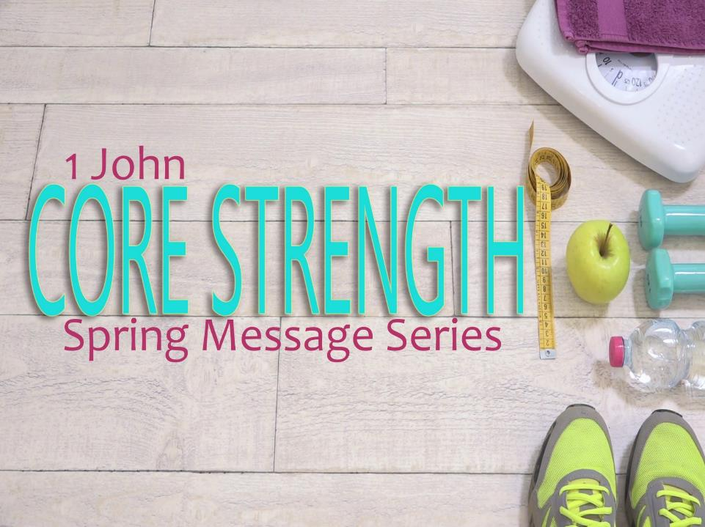
Partial Commitment Doesn’t Cut It!
“But if we confess our sins, He is faithful and just to forgive us our sins and cleanse us from everything we’ve done wrong.” ~1 John 1:9

Slide 2
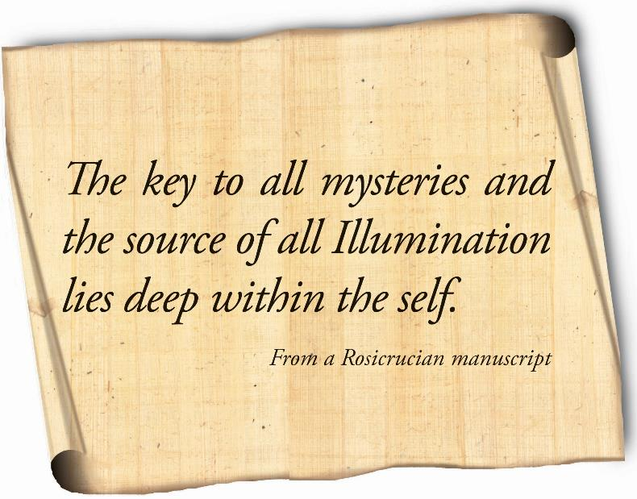
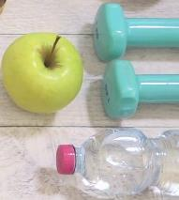

Slide 3
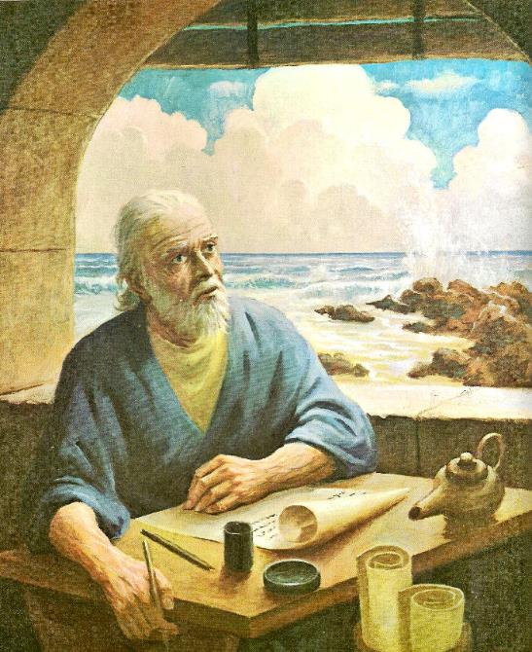

Slide 4

1 JOHN
1 JOHN

Slide 5
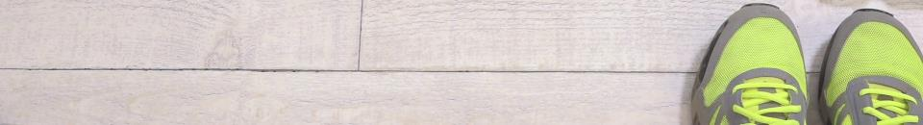
1 John 1:8 – 2:11
⁸ If we say that we have not sinned, we are fooling ourselves, and the truth isn’t in our hearts. ⁹ But if we confess our sins to God, He can always be trusted to forgive us and take our sins away. ¹⁰ If we say that we have not sinned, we make God a liar, and His message isn’t in our hearts.

Slide 6

Partial Commitment Doesn't Cut It!
¹The truth is we are sinners and need cleansing

Slide 7
1 John 1:8 – 2:11
^{2:1} My children, I am writing this so that you won’t sin. But if you do sin, Jesus Christ always does the right thing, and He will speak to the Father for us. ² Christ is the sacrifice that takes away our sins and the sins of all the world’s people.

Slide 8
Partial Commitment Doesn't Cut It!
²The truth is that we don’t have to sin
¹The truth is we are sinners and need cleansing

Slide 9
1 John 1:8 – 2:11
³ When we obey God, we are sure that we know Him. ⁴ But if we claim to know Him and don't obey Him, we are lying and the truth isn't in our hearts. ⁵ We truly love God only when we obey Him as we should, and then we know that we belong to Him. ⁶ If we say we are His, we must follow the example of Christ.

Slide 10
1 John 1:8 – 2:11
⁷ My dear friends, I am not writing to give you a new commandment. It is the same one that you were first given, and it is the message you heard. ⁸ But it really is a new commandment, and you know its true meaning, just as Christ does. You can see the darkness fading away and the true light already shining.

Slide 11
1 John 1:8 – 2:11
⁹ If we claim to be in the light and hate someone, we are still in the dark. ¹⁰ But if we love others, we are in the light, and we don’t cause problems for them. ¹¹ If we hate others, we are living and walking in the dark. We don’t know where we are going, because we can’t see in the dark.

Slide 12
Partial Commitment Doesn't Cut It!
³The truth is that not sinning means loving
¹The truth is we are sinners and need cleansing
²The truth is that we don’t have to sin

Slide 13


He is not the enemy!
She is not the problem!
I choose to love him!
I will put her self interest above my own!

Slide 14
