Slide 1
Someone Else’s Dirt
“You prepared this salvation in the presence of all peoples. It’s a light for
revelation to the Gentiles and a glory for your people Israel.” ~Luke 2:31-32

Slide 2
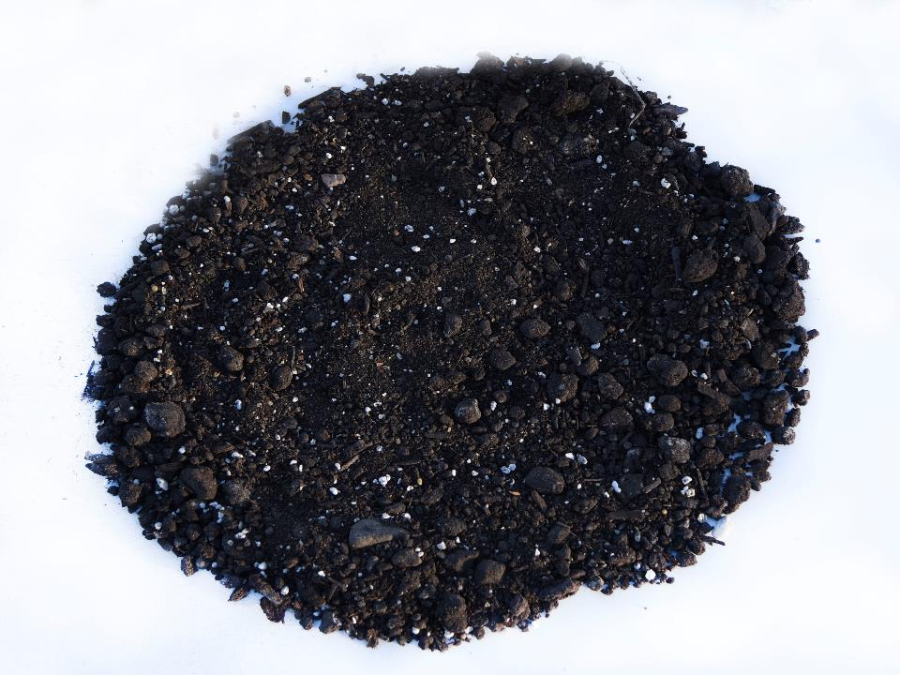

Slide 3
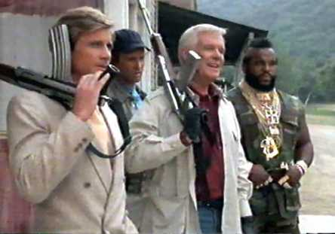

Slide 4
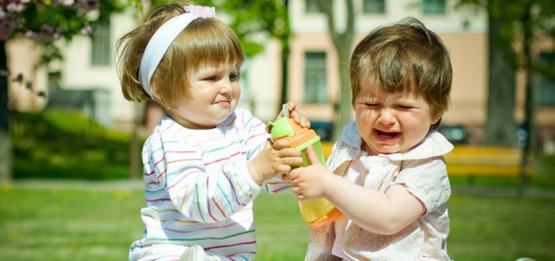

Slide 6
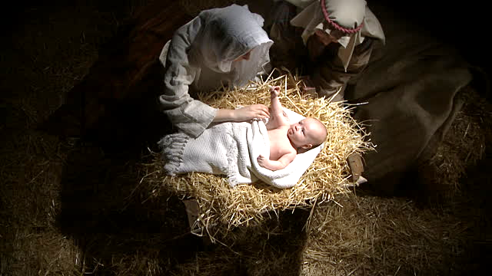

Slide 7
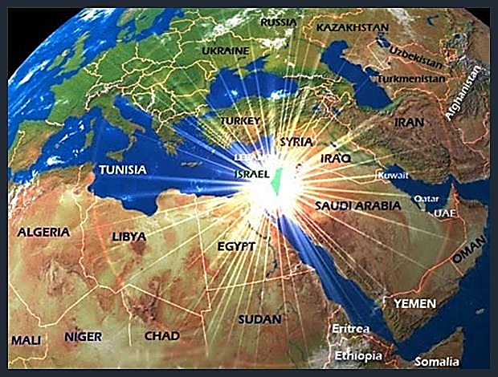

Slide 8
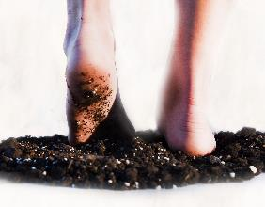
Genesis 12:1
“The Lord said to Abram, ‘Leave your land, your family, and your father’s household for the land that I will show you. I will make of you a great nation and will bless you. I will make your name respected, and you will be a blessing. I will bless those who bless you, those who curse you I will curse; all the families of the earth will be blessed because of you.’”

Slide 9
Psalm 67
¹ Let God grant us grace and bless us; let God make his face shine on us,
² so that your way becomes known on earth, so that your salvation becomes known among all the nations.
³ Let the people thank you, God! Let all the people thank you!
⁴ Let the people celebrate and shout with joy because you judge the nations fairly and guide all nations on the earth.

Slide 10
Malachi 1:11
Nevertheless, from sunrise to sunset, my name will be great among the nations. Incense and a pure grain offering will be offered everywhere in my name, because my name is great among the nations, says the Lord of heavenly forces.

Slide 11
Isaiah 42
¹ But here is my servant, the one I uphold; my chosen, who brings me delight. I’ve put my spirit upon Him; He will bring justice to the nations.
⁶ I, the Lord, have called you for a good reason. I will grasp your hand and guard you, and give you as a covenant to the people, as a light to the nations.

Slide 12
Isaiah 49:6
⁶ He said: It is not enough, since you are my servant, to raise up the tribes of Jacob and to bring back the survivors of Israel. Hence, I will also appoint you as light to the nations so that my salvation may reach to the end of the earth.

Slide 13
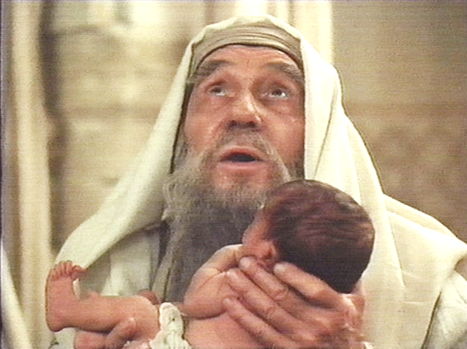
“You prepared this salvation in the presence of all peoples. It’s a light for
revelation to the Gentiles and a glory for your people Israel.” ~Luke 2:31-32

Slide 14
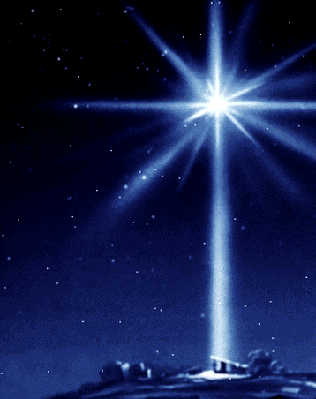

Slide 15
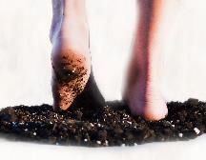
Matthew 2:1-12 (CEB)
¹ After Jesus was born in Bethlehem in the territory of Judea during the rule of King Herod, magi came from the east to Jerusalem. ² They asked, “Where is the newborn king of the Jews? We’ve seen His star in the east, and we’ve come to honor Him.” ³ When King Herod heard this, he was troubled, and everyone in Jerusalem was troubled with him. ⁴ He gathered all the chief priests and the legal experts and asked them where the Christ was to be born.

Slide 16
Matthew 2:1-12 (CEB)
⁵ They said, “In Bethlehem of Judea, for this is what the prophet wrote: ⁶ You, Bethlehem, land of Judah, by no means are you least among the rulers of Judah, because from you will come one who governs, who will shepherd my people Israel.” ⁷ Then Herod secretly called for the magi and found out from them the time when the star had first appeared. ⁸ He sent them to Bethlehem, saying, “Go and search carefully for the child. When you’ve found Him, report to
me so that I too may go and honor
Him.”

Slide 17
Matthew 2:1-12 (CEB)
⁹ When they heard the king, they went; and look, the star they had seen in the east went ahead of them until it stood over the place where the child was. ¹⁰ When they saw the star, they were filled with joy. ¹¹ They entered the house and saw the child with Mary his mother. Falling to their knees, they honored Him. Then they opened their treasure chests and presented him with gifts of gold, frankincense, and myrrh. ¹² Because they were warned in a dream not to return to Herod,
they went back to their own country
by another route.

Slide 18
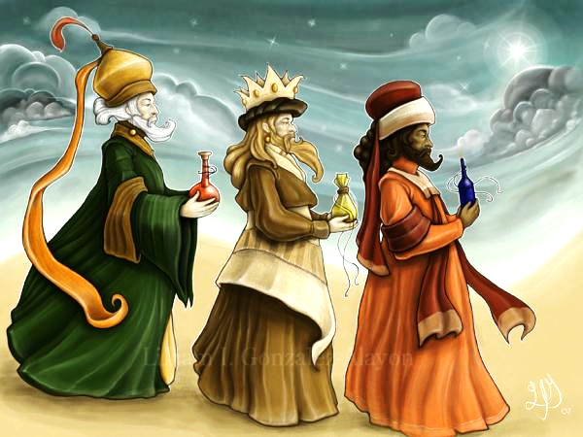

Slide 19
Matthew 28 “The Great Commission”
¹⁹ “Therefore, go and make disciples of all nations, baptizing them in the name of the Father and of the Son and of the Holy Spirit, ²⁰ teaching them to obey everything that I’ve commanded you. Look, I myself will be with you every day until the end of this present age.”

Slide 20
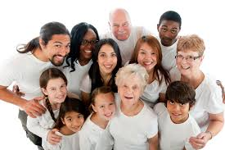

Slide 21
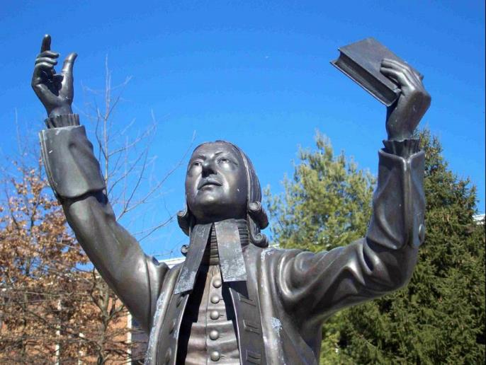
“I look upon all the world as my parish; thus far I mean,
that, in whatever part of it I am, I judge it meet, right, and my bounden duty to declare unto all that are willing to hear the glad
tidings of salvation.” ~John Wesley

