Slide 1
Getting Our Feet Dirty
“Peter said to Jesus, ‘We have left all we had
to follow you!’” Luke 18:28

Slide 2
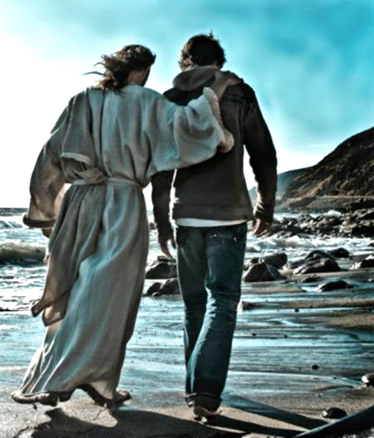

Slide 3
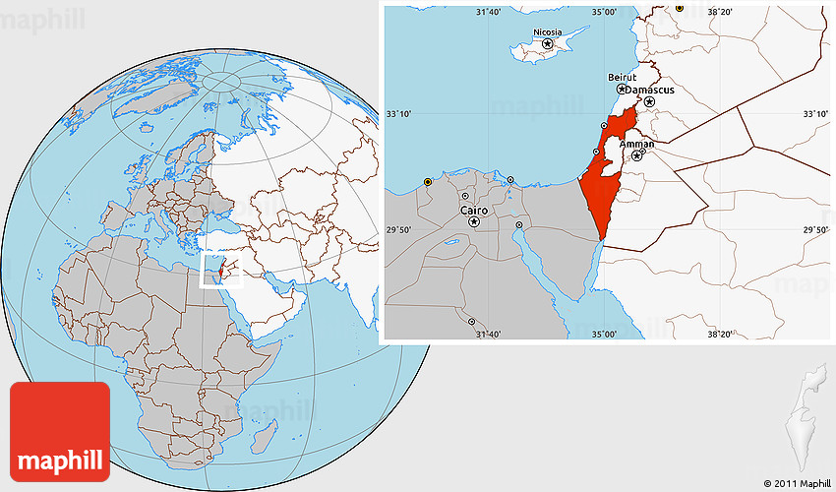

Slide 5
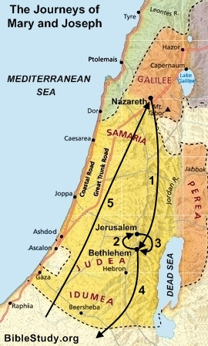

Slide 6
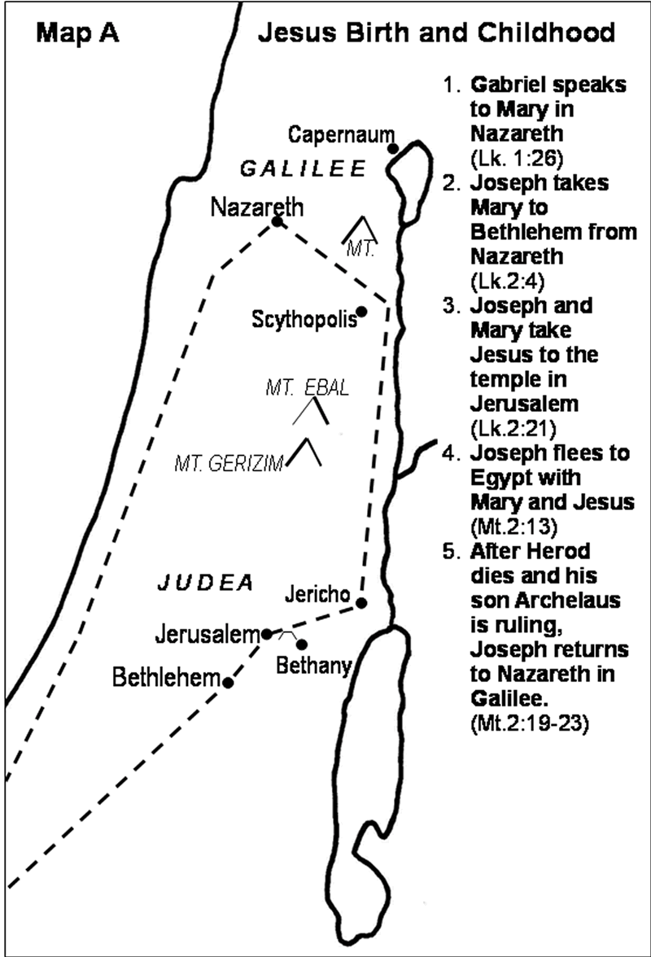

Slide 7
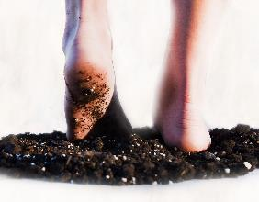
Jesus’ 3½ Years of Public Ministry
(perhaps AD 30-33)
Jesus begins Public Ministry (Beginning months)
Baptism, temptation, calling the first disciples
Year of Inauguration (First Year)
1st Passover (Jesus celebrates in Jerusalem)
Jesus moves to Capernaum and selects
12 apostles who travel with Him
Jesus travels throughout Galilee,
preaching, teaching, and working miracles
Year of Popularity (Second Year)
2nd Passover (Jesus celebrates in Jerusalem)
Jesus makes three tours of Galilee, speaking in parables
Large crowds follow Jesus. Many want to make Him king.

Slide 8
Jesus’ 3½ Years of Public Ministry
(perhaps AD 30-33)
Year of Opposition (Third Year)
3rd Passover (Jesus celebrates in Galilee)
Jesus teaches on the cost of following Him; many disciples desert
Jesus’ Gentile Tour: Tyre & Sidon, the Decapolis
Jewish leaders challenge Jesus
Jesus’ Transfiguration; heads for Jerusalem
Arrives in Judea in October
Judean tour, often sparring with Jewish leaders
Last Days (6 weeks)
Enters Jerusalem in fanfare, in March.
Celebrates the Passover (Last Supper)
Crucified, raised, and ascended back to Heaven

Slide 9
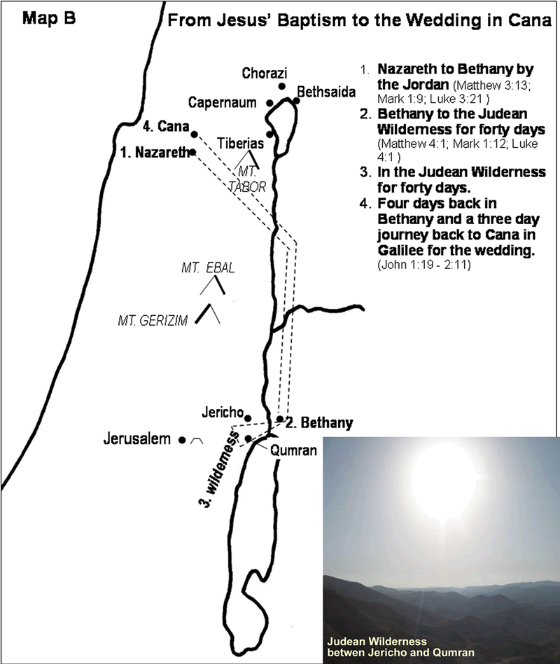

Slide 10
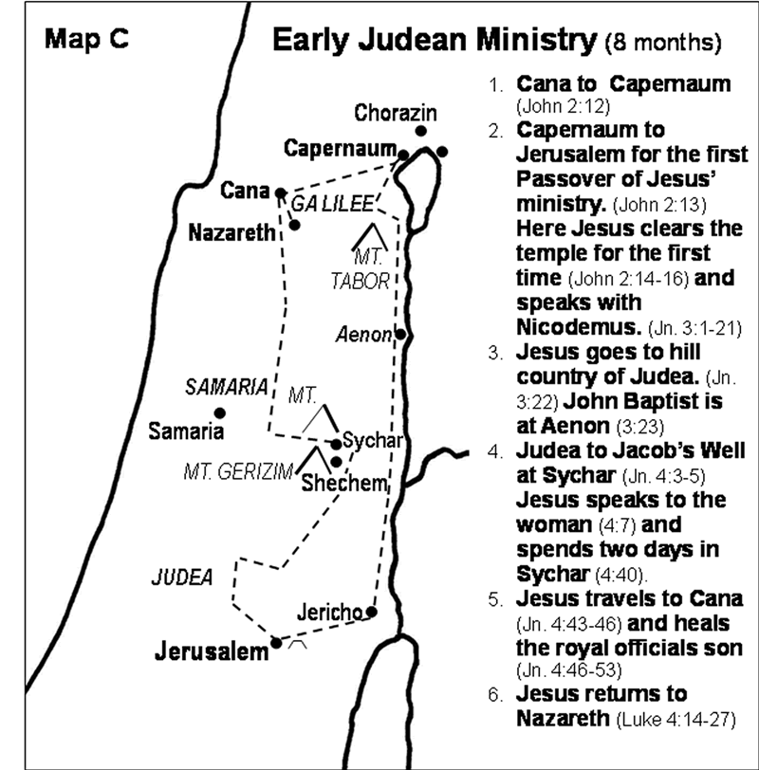

Slide 11
Luke 4:18-19 (CEB)
“The Spirit of the Lord is upon me, because the Lord has anointed me. He has sent me to preach good news to the poor, to proclaim release to the prisoners and recovery of sight to the blind, to liberate the oppressed, and to proclaim the year of the Lord’s favor.”

Slide 12
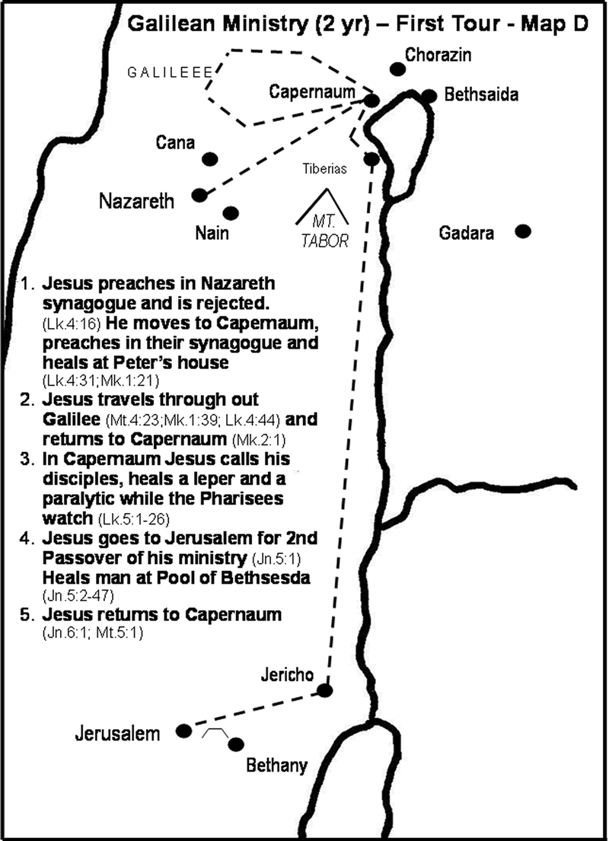

Slide 13
John 1:35-42 (CEB)
³⁵ The next day John [the Baptist] was standing again with two of his disciples. ³⁶ When he saw Jesus walking along he said, “Look! The Lamb of God!” ³⁷ The two disciples heard what he said, and they followed Jesus.
³⁸ When Jesus turned and saw them following, he asked, “What are you looking for?”
They said, “Rabbi (which is translated Teacher), where are you staying?”
³⁹ He replied, “Come and see.” So
they went and saw where He was staying,
and they remained with Him that day. It
was about four o’clock in the afternoon.

Slide 14
John 1:35-42 (CEB)
⁴⁰ One of the two disciples who heard what John said and followed Jesus was Andrew, the brother of Simon Peter. ⁴¹ He first found his own brother Simon and said to him, “We have found the Messiah” (which is translated Christ). ⁴² He led him to Jesus.
Jesus looked at him and said, “You are Simon, son of John. You will be
called Cephas” (which is translated
Peter).

Slide 15
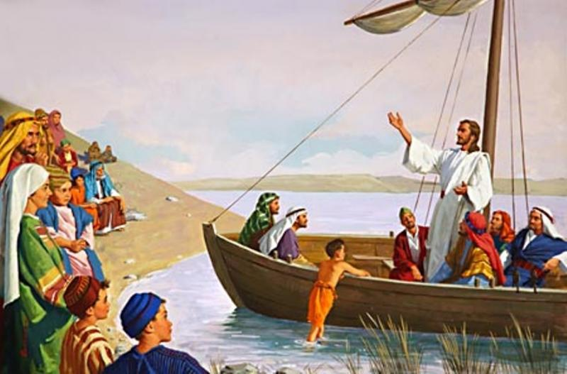

Slide 16
Luke 5:1-11 (CEB)
¹ One day Jesus was standing beside Lake Gennesaret when the crowd pressed in around Him to hear God’s word. ² Jesus saw two boats sitting by the lake. The fishermen had gone ashore and were washing their nets.
³ Jesus boarded one of the boats, the one that belonged to Simon, then asked him to row out a little distance from the shore. Jesus sat down and taught the crowds from the boat. ⁴ When He finished speaking to the crowds, He said to Simon, “Row out farther, into the deep water,
and drop your nets for a catch.”
⁵ Simon replied, “Master, we’ve
worked hard all night and caught nothing.
But because you say so, I’ll drop the nets.”

Slide 17
Luke 5:1-11 (CEB)
⁶ So they dropped the nets and their catch was so huge that their nets were splitting. ⁷ They signaled for their partners in the other boat to come and help them. They filled both boats so full that they were about to sink.
⁸ When Simon Peter saw the catch, he fell at Jesus’ knees and said, “Leave me, Lord, for I’m a sinner!” ⁹ Peter and those with him were overcome with amazement because of the number of fish they caught. ¹⁰ James and John, Zebedee’s sons, were Simon’s partners and they were amazed too.
Jesus said to Simon, “Don’t be afraid. From
now on, you will be fishing for people.” ¹¹ As soon
as they brought the boats to the shore, they left
everything and followed Jesus.

Slide 18
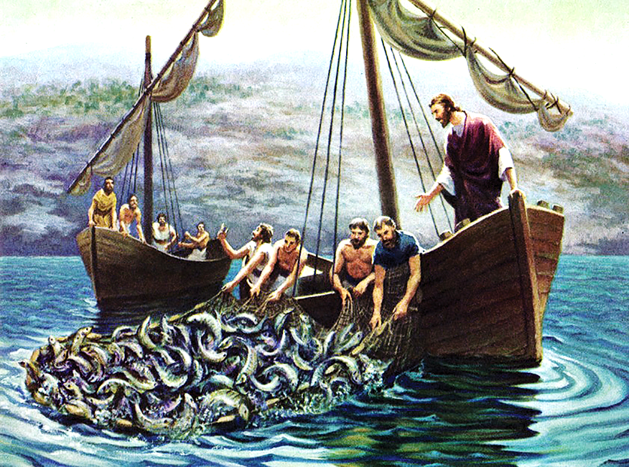

Slide 19
Getting OUR Feet Dirty
Letting Jesus be the Master
“Simon replied, ‘Master, we’ve worked hard all night and caught nothing. But because you say so, I’ll drop the nets.’” Luke 5:5

Slide 20
Getting OUR Feet Dirty
Letting Jesus be the Master
Hearing the call
“Jesus said to Simon, ‘Don’t be afraid. From now on, you will be fishing for people.’” Luke 5:10b

Slide 21
Getting OUR Feet Dirty
Letting Jesus be the Master
Hearing the call
Leaving everything else
“As soon as they brought the boats to the shore, they left everything and followed Jesus.” Luke 5:11

