Slide 1
Staying Stuck
“That evening after sunset the people brought to Jesus all the sick and demon possessed. The whole town gathered at the door, and
Jesus healed many of those who had various diseases.” Mark 1:32-34a

Slide 2
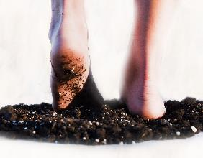
Romans 13 (CEB)
“¹ Every person should place themselves under the authority of the government. There isn’t any authority unless it comes from God, and the authorities that are there have been put in place by God. ² So anyone who opposes the authority is standing against what God has established. ... ⁴ It is God’s servant given for your benefit. ... ⁵ That is why it is necessary to place yourself under the government’s authority. 6 You should
also pay taxes for the same reason,
because the authorities are God’s
assistants ....”

Slide 3
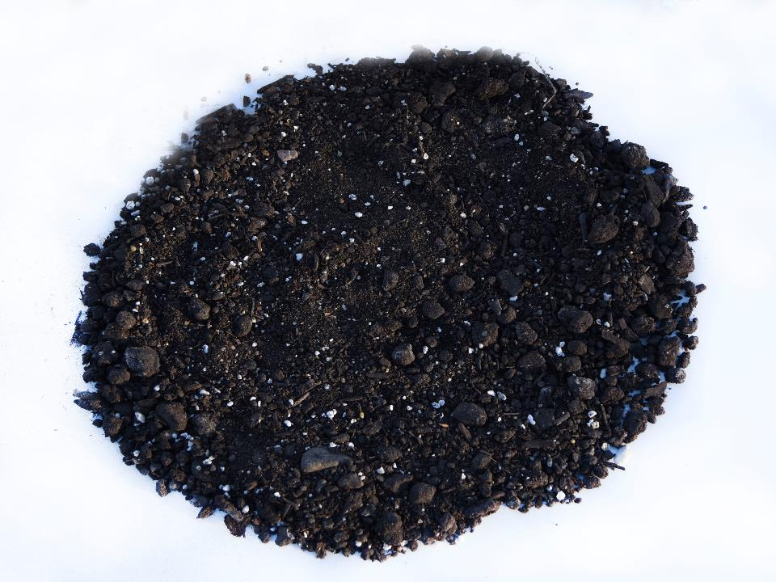
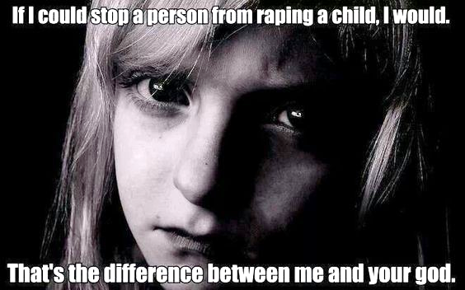

Slide 4
Theodicy
God is good.
“No one is good–except God alone.” ~Jesus, Mark 10:10. (See also Psalm 100:5, Jer. 33:11, Nahum 1:7, etc.)

Slide 5
Theodicy
God is good.
God wants only good things for His people.
“The Lord is good to all, and His mercy is over all that He has made.” -Psalm 145:9

Slide 6
Theodicy
God is good.
God wants only good things for His people.
God can do anything.
“But all things are possible for God.” ~ Jesus, Matt. 19:26 (See also Eph. 3:20)

Slide 7
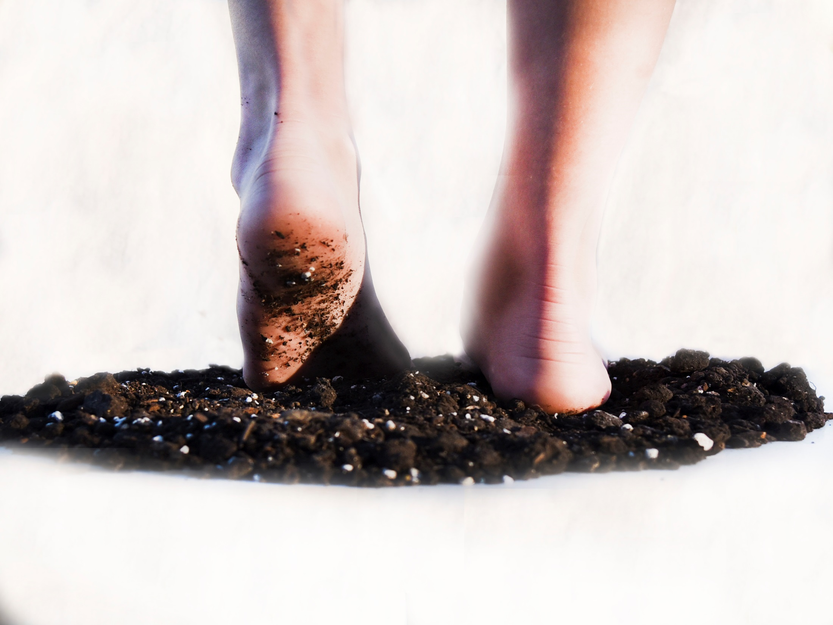
Why does God allow evil?

Slide 9
James 5 (CEB)
¹³ If any of you are suffering, they should pray. ... ¹⁴ If any of you are sick, they should call for the elders of the church, and the elders should pray over them, anointing them with oil in the name of the Lord. ¹⁵ Prayer that comes from faith will heal the sick, for the Lord will restore them to health. And if they have sinned, they will be forgiven. 16 For this reason, confess your sins to each other and pray for each other so that you may
be healed. The prayer of the
righteous person is powerful in
what it can achieve.

Slide 10
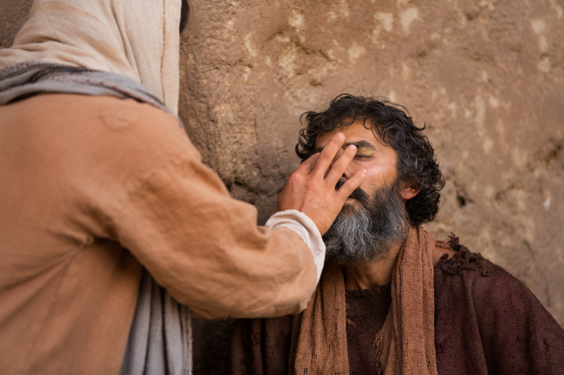

Slide 11
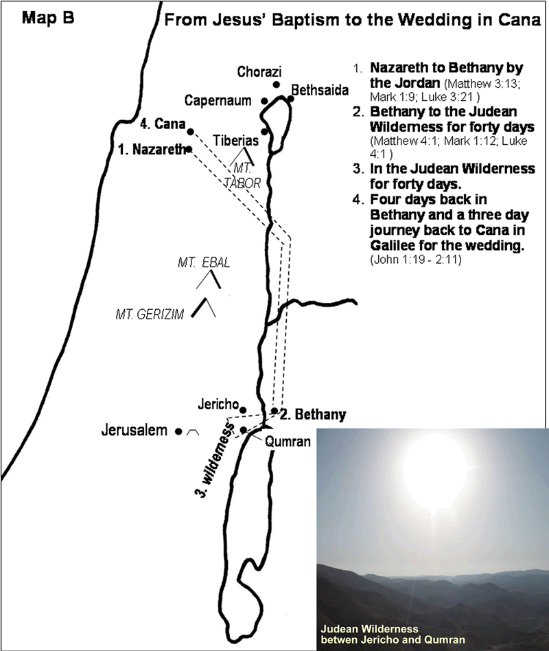

Slide 12
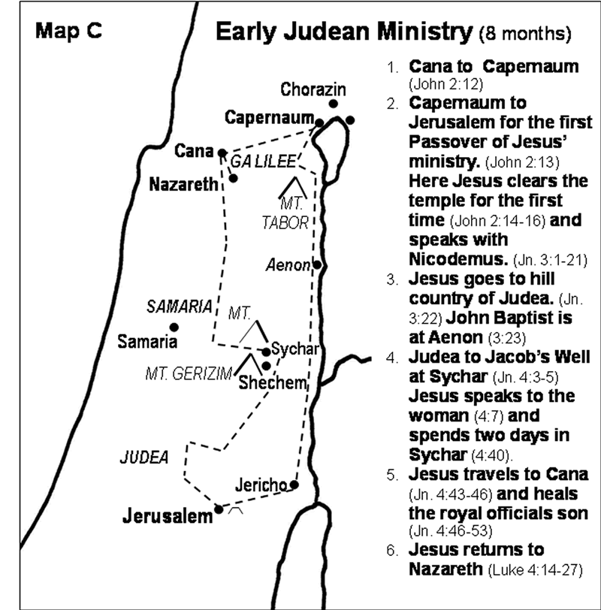

Slide 13
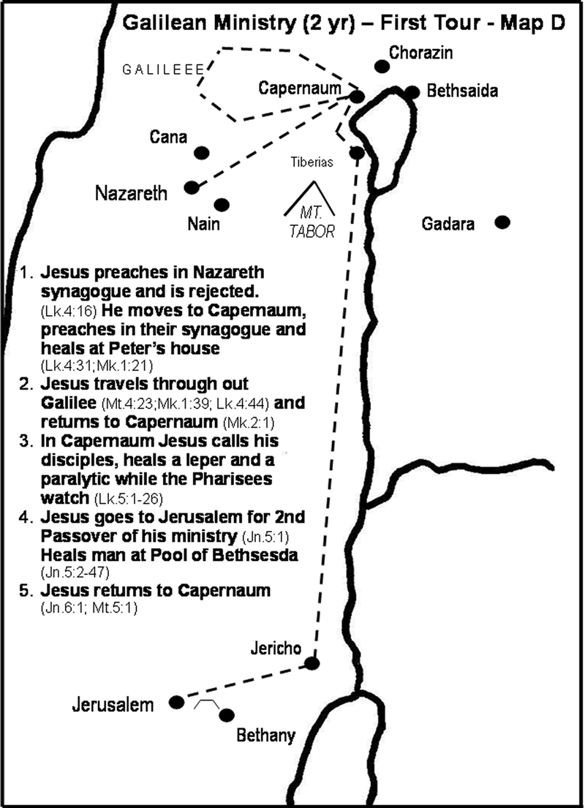

Slide 14
Jesus’ 3½ Years of Public Ministry
(perhaps AD 30-33)
Jesus begins Public Ministry (Beginning months)
Baptism, temptation, calling the first disciples
Year of Inauguration (First Year)
1st Passover (Jesus celebrates in Jerusalem)
Jesus moves to Capernaum and selects
12 apostles who travel with Him
Jesus travels throughout Galilee,
preaching, teaching, and working miracles
Year of Popularity (Second Year)
2nd Passover (Jesus celebrates in Jerusalem)
Jesus makes three tours of Galilee, speaking in parables
Large crowds follow. Many want to make Him king.

Slide 15
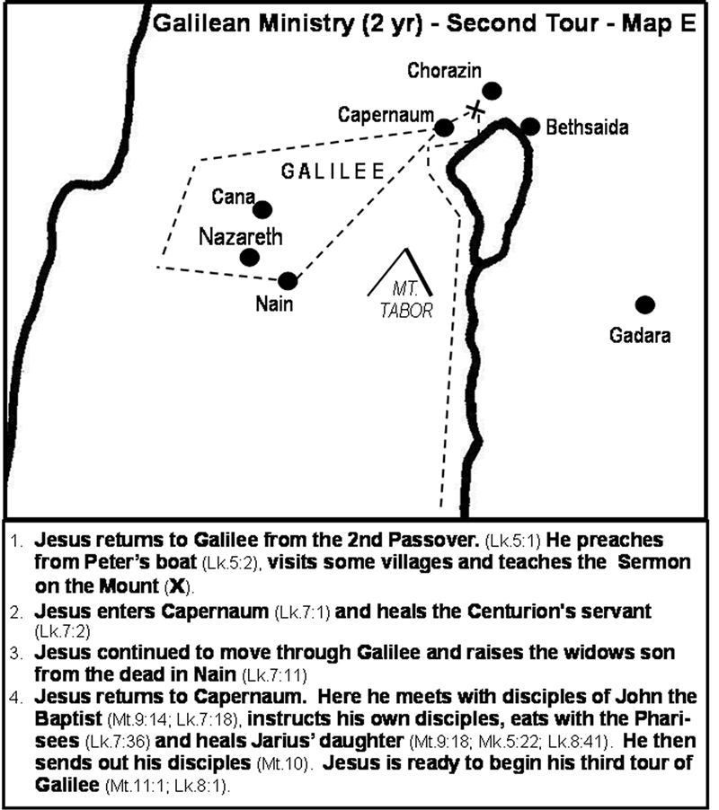

Slide 16
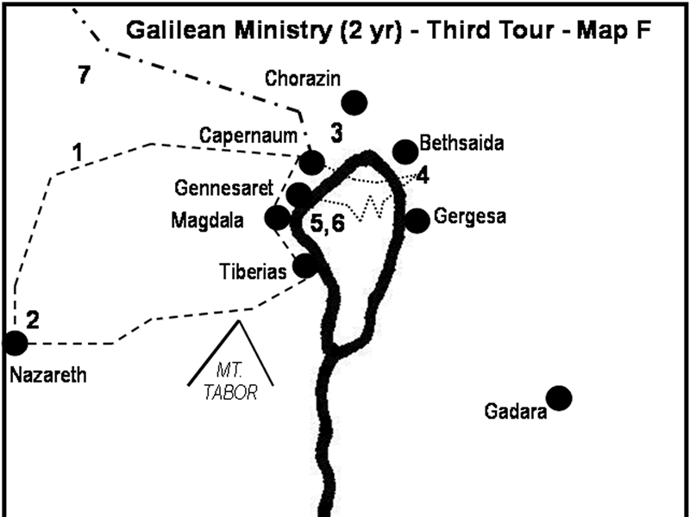

Slide 17
Matthew 8:16
“When evening came, many who were demon possessed were brought to Him, and He drove out the spirits with a word and healed all the sick.”
Mark 1:32-34a
“That evening after sunset
the people brought to Jesus all the sick and demon possessed. The whole town gathered at the door, and Jesus healed many of those who had various diseases.”

Slide 18
Matthew 9:1-8 (CEB)
¹ Jesus stepped into a boat, crossed over and came to His own town. ² Some men brought to Him a paralyzed man, lying on a mat. When Jesus saw their faith, He said to the man, “Take heart, son; your sins are forgiven.” ³ At this, some of the teachers of the law said to themselves,
“This fellow is blaspheming!”

Slide 19
Matthew 9:1-8 (CEB)
⁴ Knowing their thoughts, Jesus said, “Why do you entertain evil thoughts in your hearts? ⁵ Which is easier: to say, ‘Your sins are forgiven,’ or to say, ‘Get up and walk’? ⁶ But I want you to know that the Son of Man has authority on earth to forgive sins.” So He said to the paralyzed man, “Get up, take your mat and go home.” ⁷ Then the man got up and went home. ⁸ When
the crowd saw this, they were
filled with awe; and they praised
God, who had given such authority
to man.

Slide 20
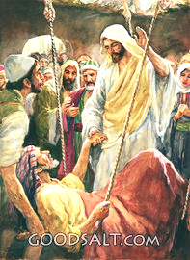

Slide 21
Staying Stuck –
Understanding God’s healings
Jesus performed miracles for a purpose: to demonstrate His divine purpose

Slide 22
Staying Stuck –
Understanding God’s healings
Jesus performed miracles for a purpose: to demonstrate His divine purpose
God has a different under-standing of “good”

Slide 23
Staying Stuck –
Understanding God’s healings
Jesus performed miracles for a purpose: to demonstrate His divine purpose
God has a different understanding of “good”
God brings good to every evil

