Slide 1
Walking Ahead of Jesus
“Go to the lost sheep, the people of Israel.”
Matthew 10:6

Slide 2
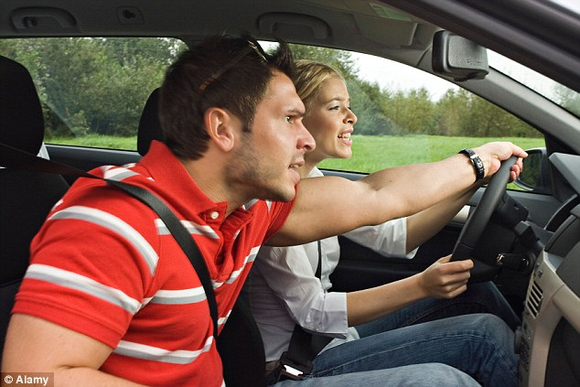

Slide 4
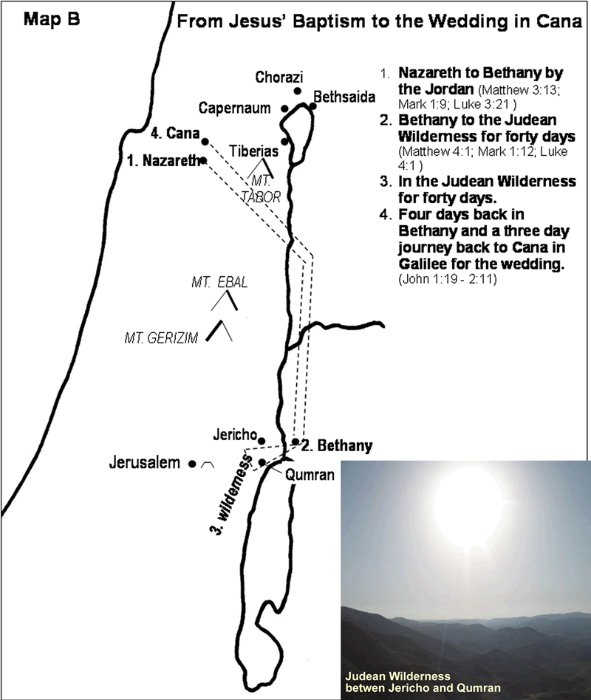

Slide 5
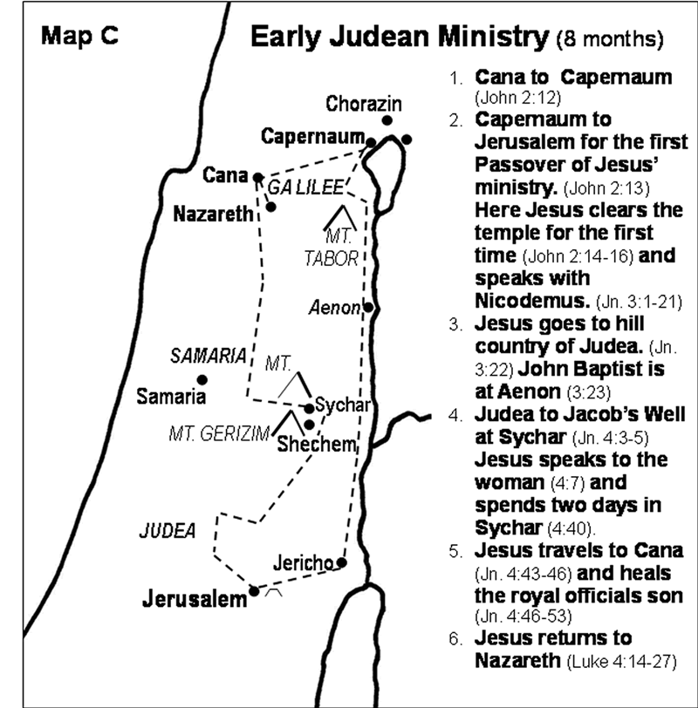

Slide 6
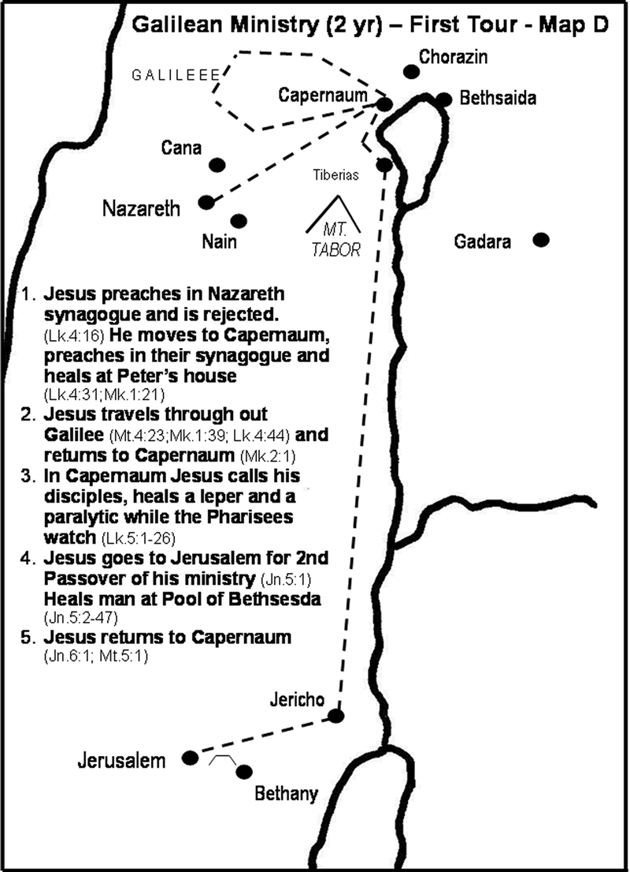

Slide 7
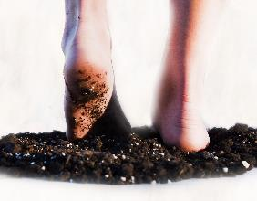
Jesus’ 3½ Years of Public Ministry
(perhaps AD 30-33)
Jesus begins Public Ministry (Beginning months)
Baptism, temptation, calling the first disciples
Year of Inauguration (First Year)
1st Passover (Jesus celebrates in Jerusalem)
Jesus moves to Capernaum and selects
12 apostles who travel with Him
Jesus travels throughout Galilee,
preaching, teaching, and working miracles
Year of Popularity (Second Year)
2nd Passover (Jesus celebrates in Jerusalem)
Jesus makes three tours of Galilee, speaking in parables
Large crowds follow. Many want to make Him king.

Slide 8
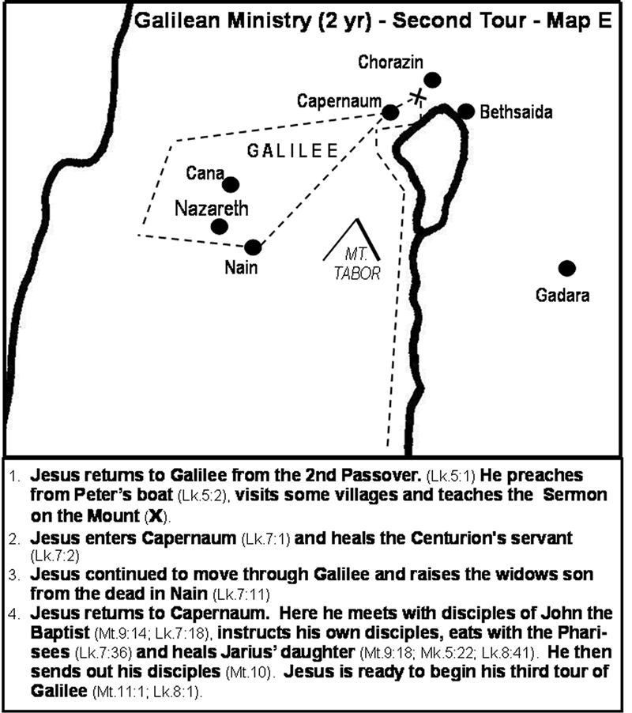

Slide 9
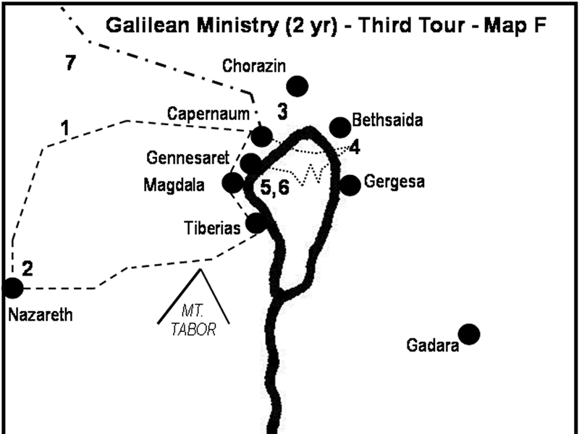

Slide 10
Matthew 10 (CEB)
⁵ Jesus sent these twelve out and commanded them, “...⁶ Go to the lost sheep, the people of Israel. ⁷ As you go, make this announcement: ‘The kingdom of heaven has come near.’ ⁸ Heal the sick, raise the dead, cleanse those with skin diseases, and throw out demons. You received without having to pay. Therefore, give without
demanding payment.”

Slide 11
Walking Ahead of Jesus
We go before we are ready

Slide 13
Luke 10 (CEB)
¹ After these things, the Lord commissioned seventy two others and sent them on ahead in pairs to every city and place He was about to go. ² He said to them, “The harvest is bigger than you can imagine, but there are few workers. Therefore, plead with the Lord of the harvest to send out workers for His harvest. ³ Go! Be warned, though, that I’m sending you out as lambs among wolves.

Slide 14
Walking Ahead of Jesus
We go before we are ready
Jesus is on His way

Slide 15
Walking Ahead of Jesus
We go before we are ready
Jesus is on His way
We are already equipped

Slide 16
Walking Ahead of Jesus
We go before we are ready
Jesus is on His way
We are already equipped
We start with prayer

Slide 17
Luke 10 (CEB)
⁴ Carry no wallet, no bag, and no sandals. Don’t even greet anyone along the way. ⁵ Whenever you enter a house, first say, ‘May peace be on this house.’ ⁶ If anyone there shares God’s peace, then your peace will rest on that person. If not, your blessing will return to you. ⁷ Remain in this house, eating and drinking whatever they set before you, for workers deserve their pay. Don’t move from house to house.

Slide 18
Luke 10 (CEB)
⁸ Whenever you enter a city and its people welcome you, eat what they set before you. ⁹ Heal the sick who are there, and say to them, ‘God’s kingdom has come upon you.’ ¹⁰ Whenever you enter a city and the people don’t welcome you, go out into the streets and say, ¹¹ ‘As a complaint against you, we brush off the dust of your city that has collected on our feet. But know this: God’s kingdom has come to you.’ ¹² I assure you that Sodom will be better off on
Judgment Day than that city.

Slide 19
Luke 10 (CEB)
¹⁷ The seventy two returned joyously, saying, “Lord, even the demons submit themselves to us in your name.”
¹⁸ Jesus replied, “I saw Satan fall from heaven like lightning. ¹⁹ Look, I have given you authority to crush snakes and scorpions underfoot. I have given you authority over all the power of the enemy. Nothing will harm you. ²⁰ Nevertheless, don’t rejoice because the spirits submit to you. Rejoice instead that your names
are written in heaven.”

Slide 20
