Slide 1
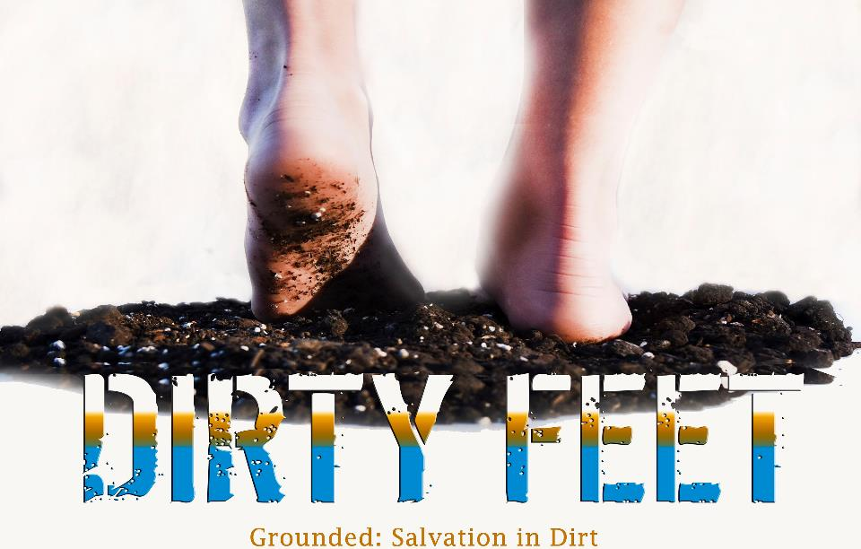
Holy (Land) Dirt!
“The next day John saw Jesus coming toward him and said, ‘Look! The Lamb of God who takes away the sin of the world! This is the one about whom I said, ‘He who comes after me is really greater than me because He existed before me.’’” ~John 1:29-30

Slide 2
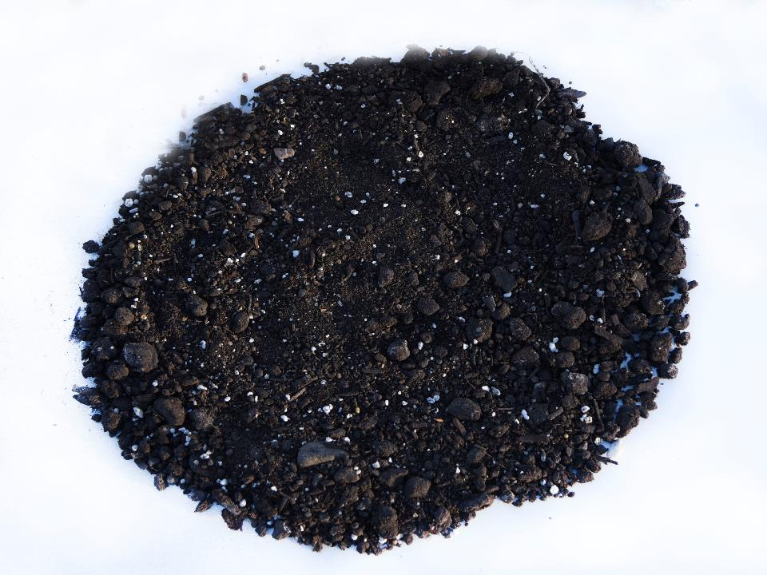
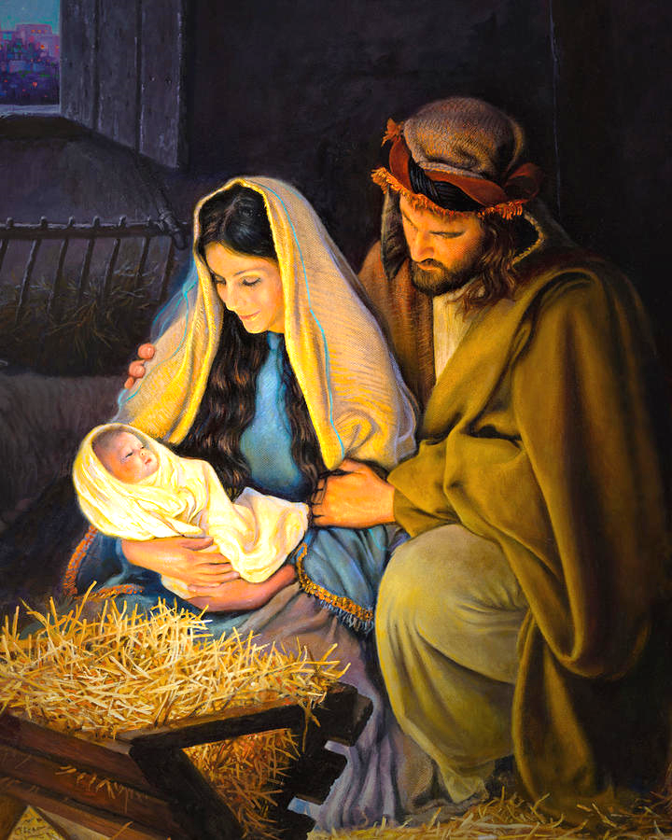

Slide 3
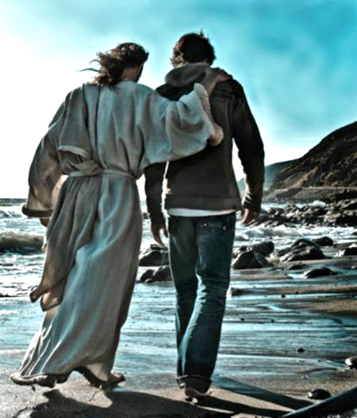

Slide 5
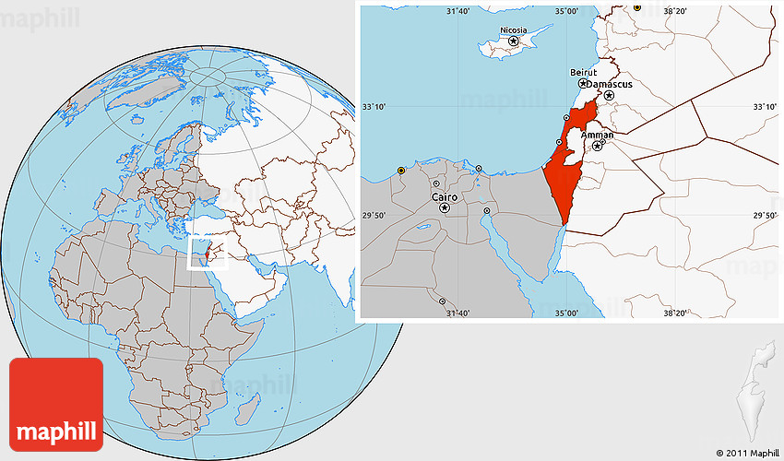

Slide 7
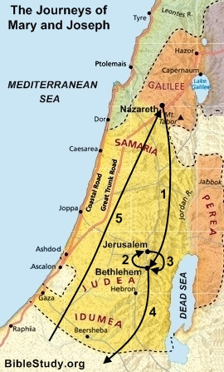

Slide 8
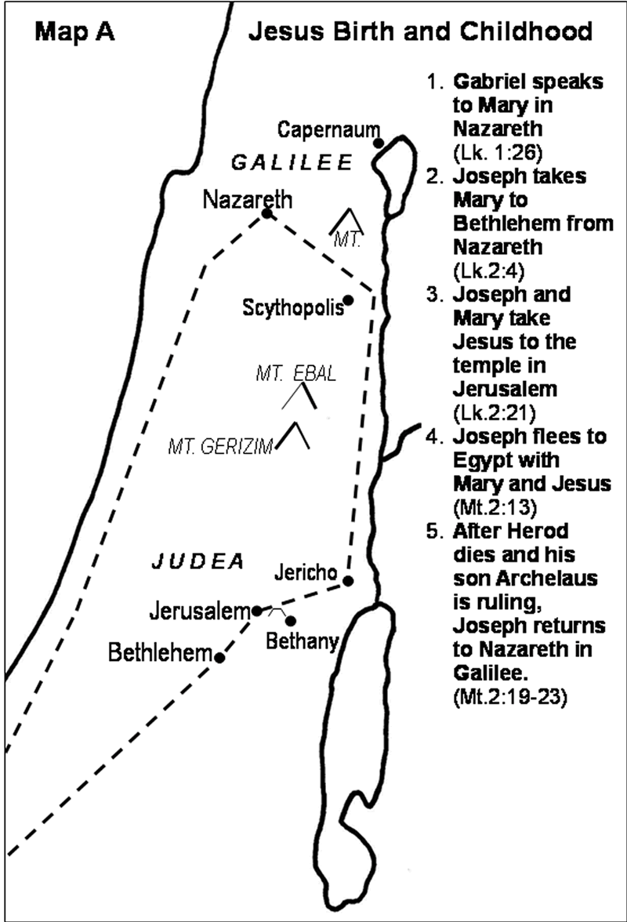

Slide 9
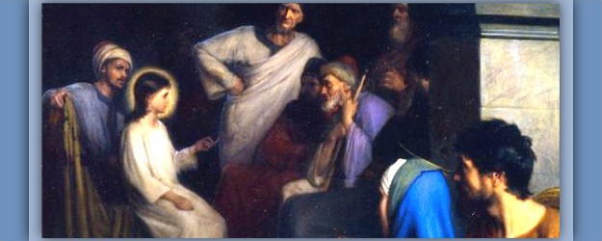

Slide 10
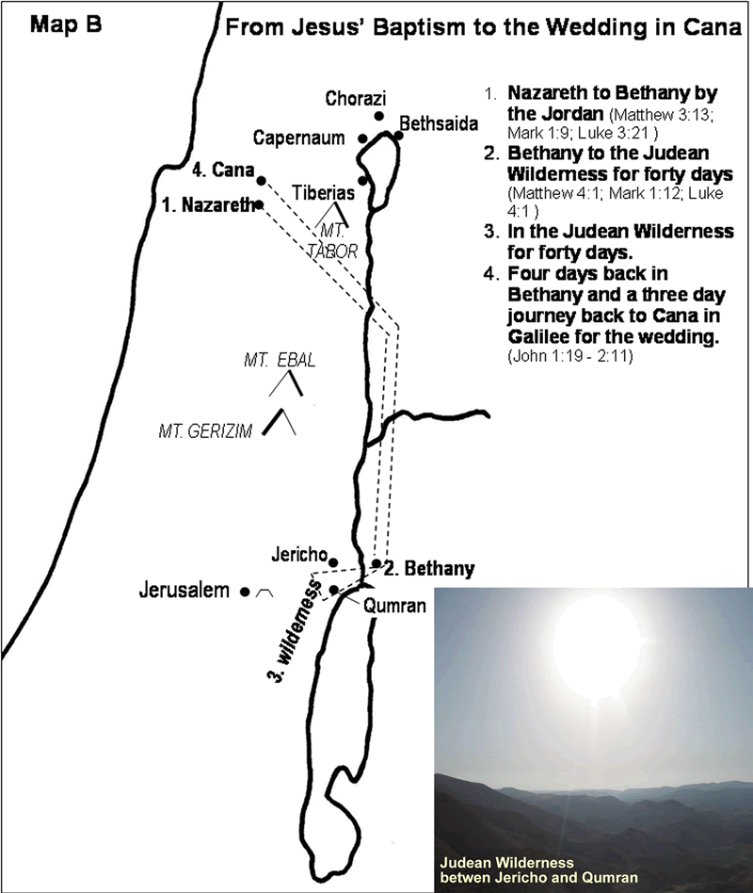

Slide 11
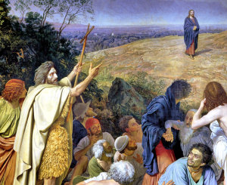

Slide 12
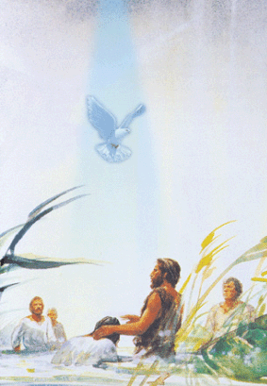

Slide 14
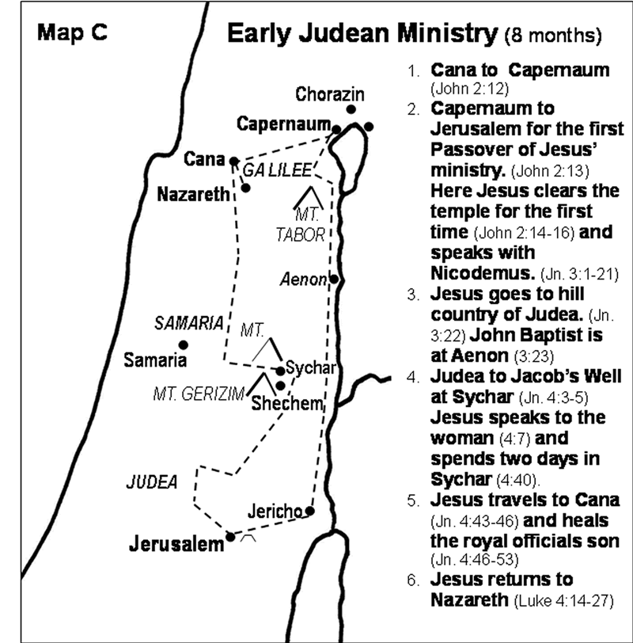

Slide 15
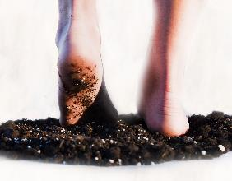
Luke 4:14-22 (CEB)
¹⁴ Jesus returned in the power of the Spirit to Galilee, and news about Him spread throughout the whole countryside. ¹⁵ He taught in their synagogues and was praised by everyone. ¹⁶ Jesus went to Nazareth, where He had been raised. On the Sabbath He went to the synagogue as he normally did, and He stood up to read.

Slide 16
Luke 4:14-22 (CEB)
¹⁷ The synagogue assistant gave Him
the scroll from the prophet Isaiah. He
unrolled the scroll and found the place where it was written:
¹⁸ “The Spirit of the Lord is upon me, because the Lord has anointed me. He has sent me to preach good news to the poor, to proclaim release to the prisoners and recovery of sight to the blind, to liberate the oppressed, ¹⁹ and to proclaim the year of the Lord’s favor.” [Isaiah 61:1 2; 58:6]

Slide 17
Luke 4:14-22 (CEB)
²⁰ He rolled up the scroll, gave it back to the synagogue assistant, and sat down. Every eye in the synagogue was fixed on Him. ²¹ He began to explain to them, “Today, this scripture has been fulfilled just as you heard it.” ²² Everyone was raving about Jesus, so impressed were they by the gracious words flowing from His lips. They said, “This is Joseph’s son, isn’t it?”

Slide 18
Luke 4:14-22 (CEB)
¹⁸ “The Spirit of the Lord is upon me, because the Lord has anointed me.
He has sent me to preach good news to the poor, to proclaim release to the prisoners and recovery of sight to the blind, to liberate the oppressed, ¹⁹ and to proclaim the year of the Lord’s favor.” ...
“Today, this scripture has been fulfilled just as you heard it.”

