Slide 1
“Suddenly Jesus met them and greeted them. They came and grabbed His feet and worshipped Him.”
~Matthew 28:9
Sunday:
Grounded in an Empty Hole
Jesus’ Passion

Slide 3
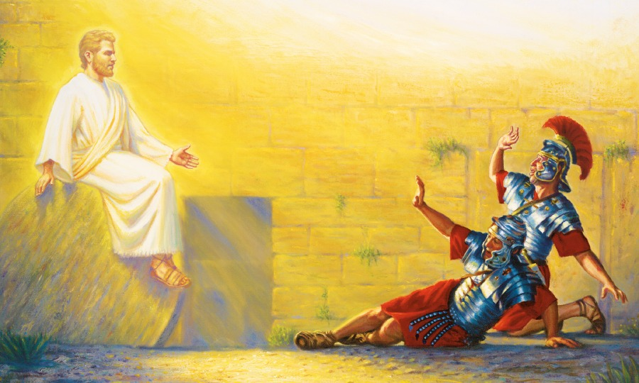

Slide 4
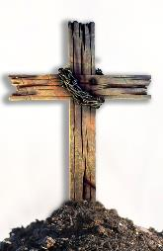
Matthew 28:1-10 (CEB)
¹ After the Sabbath, at dawn on the first day of the week, Mary Magdalene and the other Mary went to look at the tomb. ² And suddenly, there was a violent earthquake, for an angel from the Lord came down from heaven and, going to the tomb, rolled back the stone and sat on it. ³ His appearance was like lightning, and his clothes were as white
as snow. ⁴ The guards were so terrified
of him that they shook with fear and
became like dead men.

Slide 5
Matthew 28:1-10 (CEB)
⁵ But the angel said to the women, “Don’t be afraid. I know that you are looking for Jesus who was crucified. ⁶ He isn’t here. He’s been raised from the dead, just as He said. Come, see the place where they laid Him. ⁷ Then hurry, go and tell His disciples, ‘He’s been raised from the dead. He’s going on
ahead of you to Galilee. You will see
Him there.’ I’ve given the message to
you.”

Slide 6
Matthew 28:1-10 (CEB)
⁸ With great fear and excitement, the women hurried away from the tomb and ran to tell His disciples. ⁹ Suddenly Jesus met them and greeted them. They came and grabbed His feet and worshipped Him. ¹⁰ Then Jesus said to them, “Don’t be afraid. Go and tell my
brothers that I am going to Galilee.
They will see me there.”

Slide 7
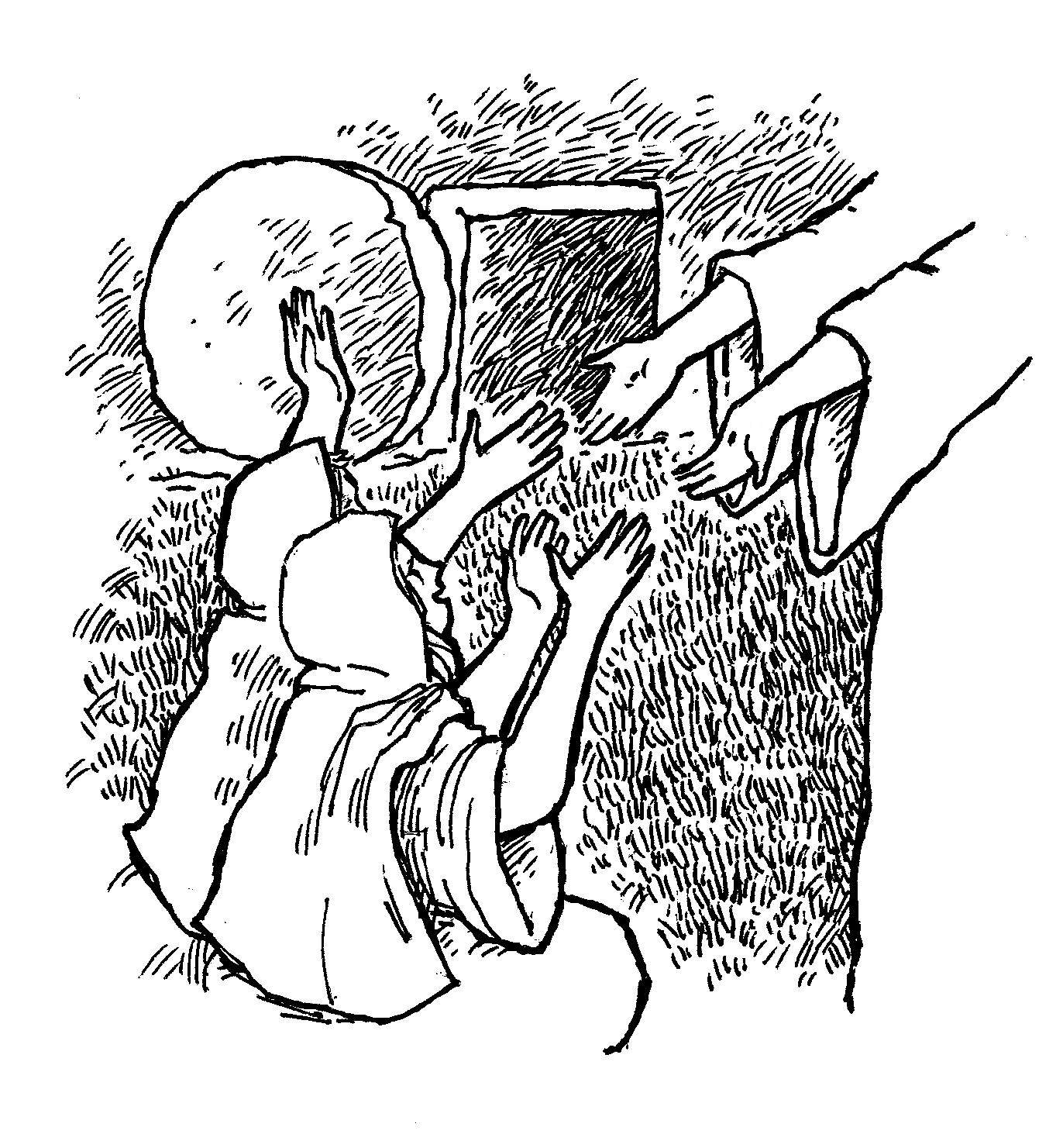

Slide 8
Grounded in an Empty Hole
Jesus’ Passion

Slide 9
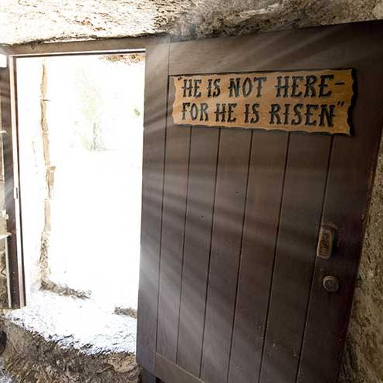

Slide 10
Grounded in an Empty Hole
Seeing more than what meets the eye
Easter
Living

Slide 11
Grounded in an Empty Hole
Seeing more than what meets the eye
Expecting God to show up
Easter
Living

Slide 12
Grounded in an Empty Hole
Seeing more than what meets the eye
Expecting God to show up
Our dirt becomes soil
Easter
Living

