Slide 1

My Wisdom
“God has raised the Lord and will raise us through His power.”
~1 Cor. 6:14

Slide 2



Slide 3
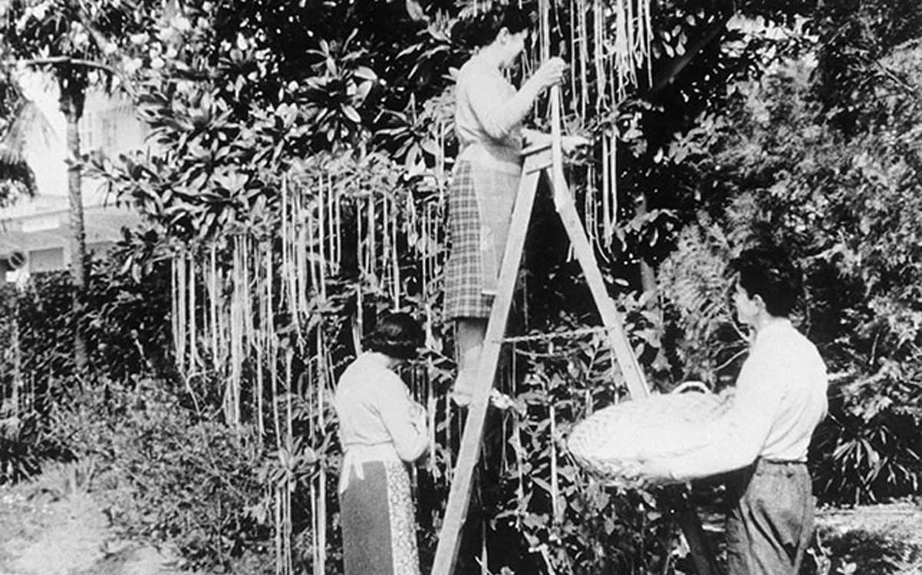

Slide 4
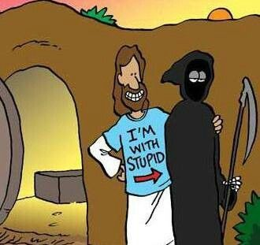

Slide 5
My Wisdom

Slide 6


Let God be bigger than
my current understanding
My Wisdom

Slide 7
¹⁸ The message of the cross is foolishness to those who are being destroyed. But it is the power of God for those of us who are being saved. ¹⁹ It is written in scripture: “I will destroy the wisdom of the wise, and I will reject the intelligence of the intelligent.” (Isaiah 29:14) ²⁰ Where are the wise? Where are the legal experts? Where are today’s debaters? Hasn’t God made the wisdom of the world foolish?
~1 Corinthians 1:18-25 (CEB)

Slide 8
²¹ In God’s wisdom, He determined that the world wouldn’t come to know Him through its wisdom. Instead, God was pleased to save those who believe through the foolishness of preaching. ²² Jews ask for signs, and Greeks look for wisdom, ²³ but we preach Christ crucified, which is a scandal to Jews and foolishness to Gentiles. ²⁴ But to those who are called—both Jews and Greeks—Christ is God’s power and God’s wisdom. ²⁵ This is because the foolishness of God is wiser than human wisdom, and the weakness of God is stronger than human strength.
~1 Corinthians 1:18-25 (CEB)

Slide 9
Change the lens by which you view reality
My Wisdom

Slide 10


Slide 11
Make Easter your new identity
My Wisdom

Slide 12
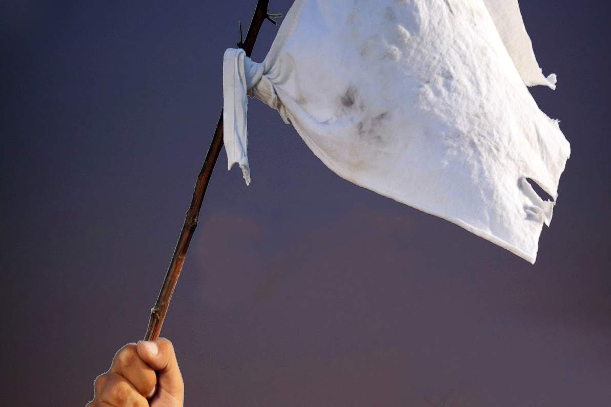

Slide 13
My Wisdom
Let God be bigger than my current understanding
Change the lens by which you view reality
Make Easter your new identity

