Slide 1

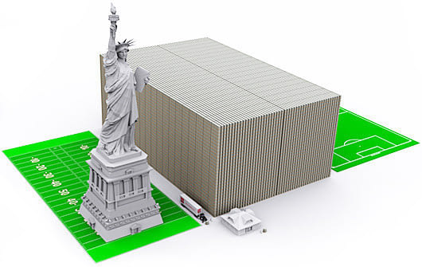

Slide 2

Keep Building!
Building a Unique Life with God
“Being confident of this, that He who began a good work in you will carry it on to completion until the day of Christ Jesus.” ~Philippians 1:6

Slide 3



Template with bricks for PowerPoint

Slide 4
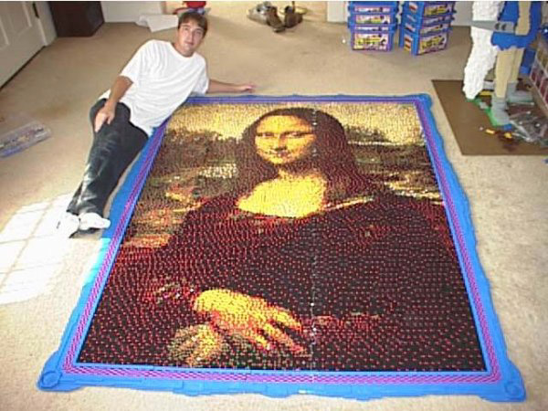
LEGO® Template
Template with bricks for PowerPoint
Notes:
© Copyright Showeet.com

Slide 5
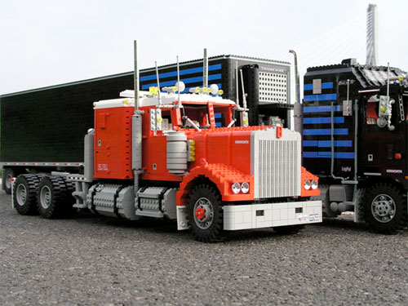
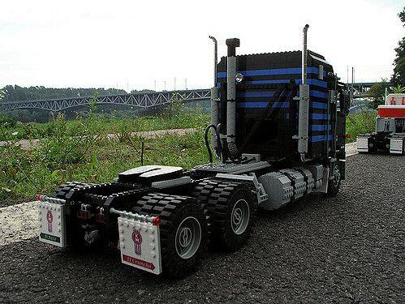
LEGO® Template
Template with bricks for PowerPoint

Slide 6
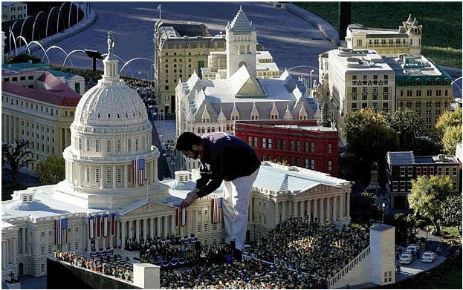
LEGO® Template
Template with bricks for PowerPoint
Notes:
© Copyright Showeet.com

Slide 7
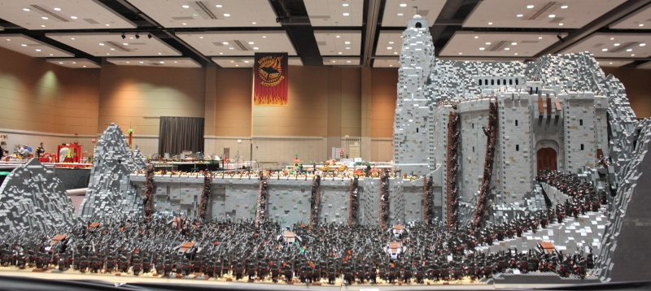
LEGO® Template
LEGO Helm's Deep ~ LOTR
Template with bricks for PowerPoint
Number of Bricks: 150,000 + extra
Number of Mini-figures: 2000; Building time (6 months with year and half preparation) Weight: about 400 pounds
Notes:
© Copyright Showeet.com

Slide 8
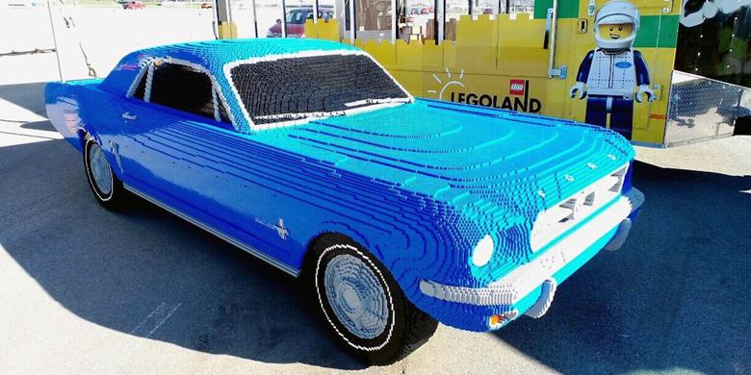
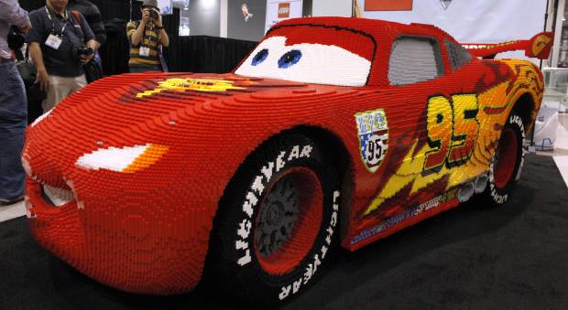
Notes:
© Copyright Showeet.com

Slide 9
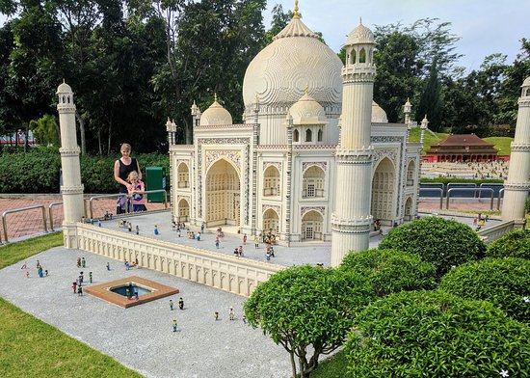
Notes:
© Copyright Showeet.com

Slide 10
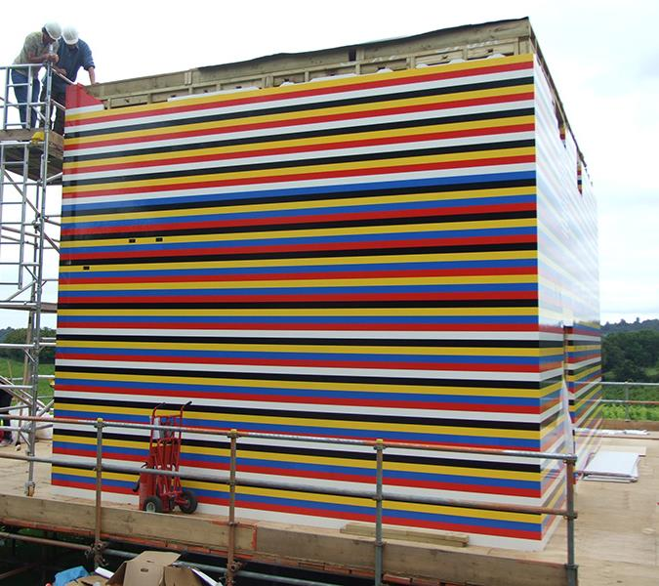
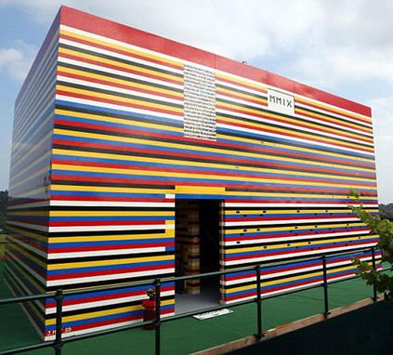
Built with the help of over 1,000 volunteers and over three million Lego bricks, James May’s Lego House is considered one of the largest projects of its kind to ever be completed. According to May, the toy house, even included a working shower and toilet.
Notes:
© Copyright Showeet.com

Slide 11
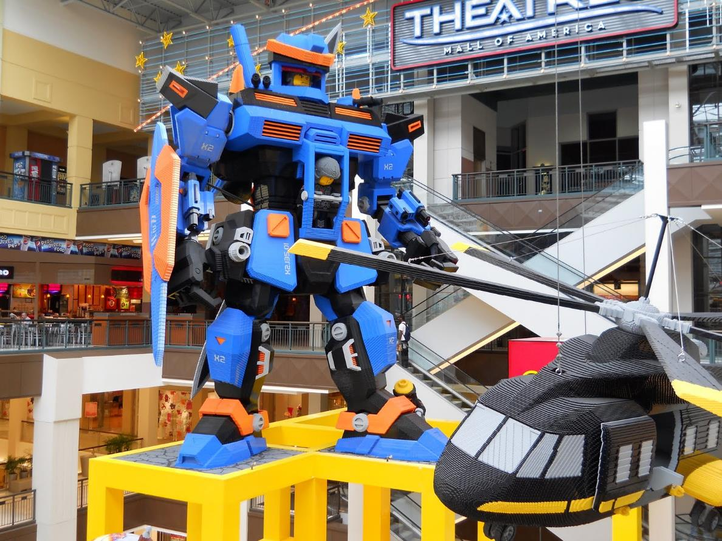
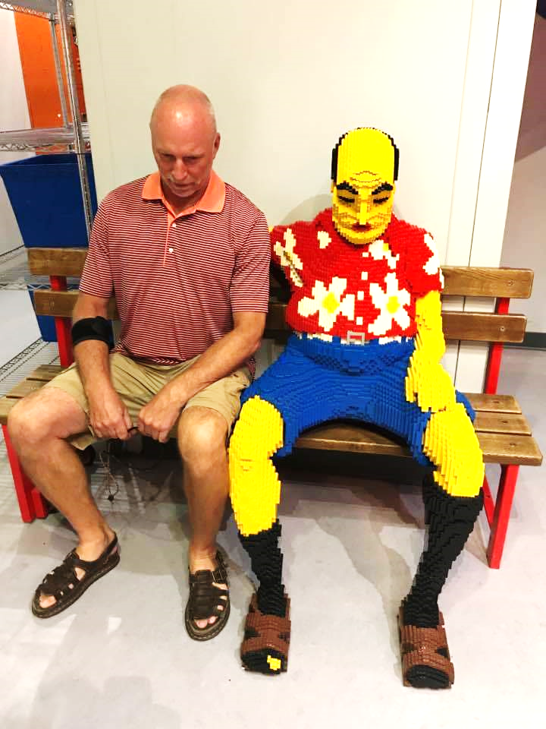
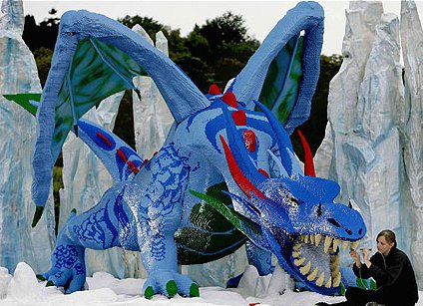
Notes:
© Copyright Showeet.com

Slide 12
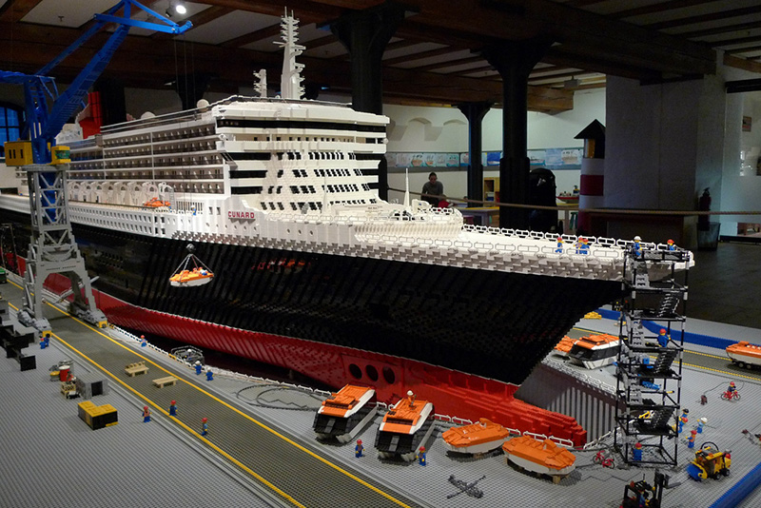
Lego bricks: 480.000, half a year building time (1200 working hours) with a length of 21 feet
Notes:
© Copyright Showeet.com

Slide 13
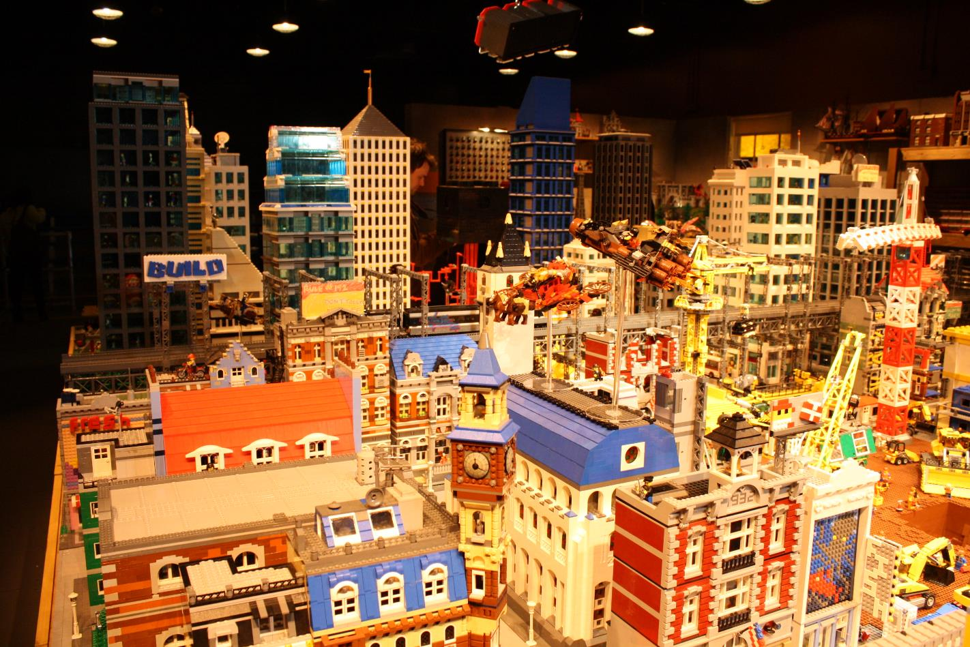
Notes:
© Copyright Showeet.com

Slide 14
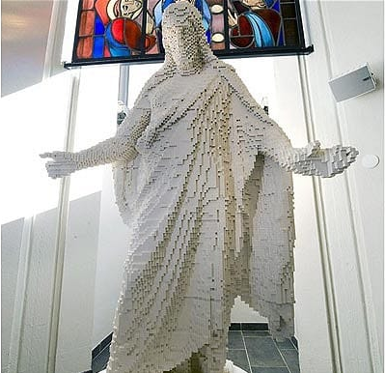
A statue of Jesus Christ made entirely out of Lego bricks stands in a church in Vasteras, Sweden. The life-size statue, a copy of Thorvaldsen's 'Resurrected Christ', took parishioners a year and a half to construct out of 30,000 tiny plastic pieces
Notes:
© Copyright Showeet.com

Slide 15
2 Peter 1:3-8 (CEB)
³ By His divine power, the Lord has given us everything we need for life and godliness through the knowledge of the One who called us by His own honor and glory. ⁴ Through His honor and glory He has given us His precious and wonderful promises, that you may share the divine nature and escape from the world’s immorality that sinful craving produces.
Notes:
© Copyright Showeet.com

Slide 16
2 Peter 1:3-8 (CEB)
⁵ This is why you must make every effort to add moral excellence to your faith; and to moral excellence, knowledge; ⁶ and to knowledge, self control; and to self control, endurance; and to endurance, godliness; ⁷ and to godliness, affection for others; and to affection for others, love. ⁸ If all these are yours and they are growing in you, they’ll keep you from becoming inactive and unfruitful in the knowledge of our Lord Jesus Christ.
Notes:
© Copyright Showeet.com

