Slide 1

Love Is Something You Do!
“Now, these three remain: faith, hope and love. But the greatest of these is love.”
~1 Cor. 13:13

Slide 2
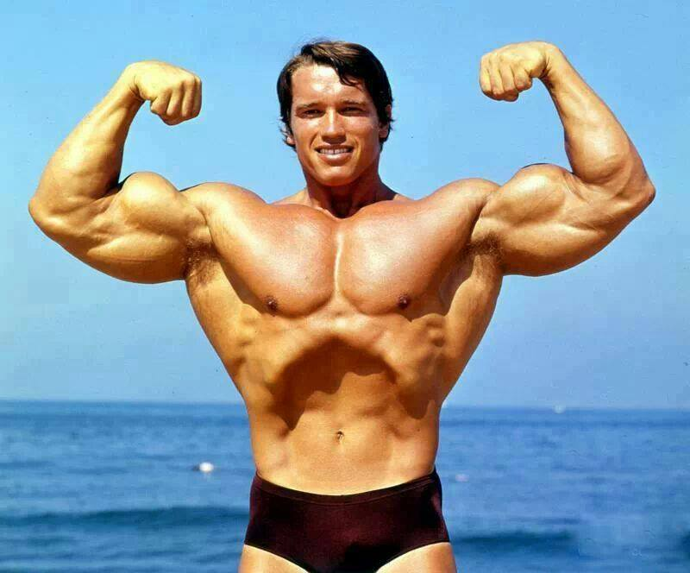



Slide 3


Bible study for life transformation!
Engaging 1 John as a model.

Slide 4

Engaging Scripture to Transform
Listen
Read it
Learn about it
Listen to what the Holy Spirit is saying
Sit with it, let it work on you
Discuss
Read it with others
Learn from others
Listen to what the Holy Spirit is saying
Meet regularly
Apply
Ask what God wants you to do about it
Make small changes in your daily life
Support from others and the Holy Spirit

Slide 5
1 John
  In the New Testament
  Almost to the end of the Bible
  Is a General Epistle (letter) - written to all Christians

Slide 6
1 John
  Author: John the Apostles (who also wrote the Gospel of John, 1,2,3 John and Revelation)
  Date: Circa 90 A.D.
  Location: Ephesus
  Audience: Christians around Asia Minor
  Purpose: A general encouragement to all Christians to stay true to Jesus.
  Written like a sermon, a message about God’s love.

Slide 7
1 John
  Theme verses of 1 John
  1 John 3:16 “This is how we know love: Jesus laid down His life for us, and we ought to lay down our lives for one another.”
  1 John 4:7-8 “Dear friends, let’s love each other, because love is from God, and everyone who loves is born from God and knows God. ... God is love.”

Slide 8
1 John
  Major themes in 1 John
  God is love
  We have fellowship with God in this love
  We love others with God’s love
  Obedience is the test of love
  We are being made holy
  God is overcoming the evil in the world

Slide 9
1 John 1:1-7
¹ We announce to you what existed from the beginning, what we have heard, what we have seen with our eyes, what we have seen and our hands handled, about the Word of Life. ² The Life was revealed, and we have seen, and we testify and announce to you the Eternal Life that was with the Father and was revealed to us. ³ What we have seen and heard, we also announce it to you so that you can have fellowship with us. Our fellowship is with the Father and with His Son, Jesus Christ. ⁴ We are writing these things so that our joy can be complete.

Slide 10
1 John 1:1-7
⁵ This is the message that we have heard from Him and announce to you: “God is light and there is no darkness in Him at all.” ⁶ If we claim, “We have fellowship with Him,” and live in the darkness, we are lying and do not act truthfully. ⁷ But if we live in the light in the same way as He is in the light, we have fellowship with each other, and the blood of Jesus, His Son, cleanses us from every sin.

Slide 11
Our “spiritual core” according to
1 John, is God’s Love
WORKING YOUR CORE:
God is love (agape: self-sacrificing commitment)
God’s love is shown best in Jesus’ sacrifice
We receive God’s love when we receive Jesus
We live God’s love through obedience
We love others with God’s love

Slide 12
Godly love is something we do!

Slide 13


