Slide 1

Pure Kids
“See what kind of love the Father has given to us in that we should be called God’s children, and that is what we are!” ~1 John 3:1

Slide 2



Slide 3
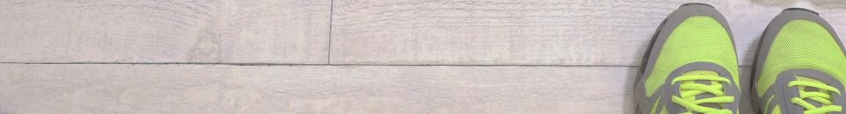
Sinlessness in 1 John
1:8 If we claim, “We don’t have any sin,” we deceive ourselves and the truth is not in us.
2:1 My little children, I’m writing these things to you so that you don’t sin. But if you do sin, we have an advocate with the Father, Jesus Christ the righteous one.
2:4 The one who claims, “I know him,” while not keeping his commandments, is a liar, and the truth is not in this person.
2:5 But the love of God is truly perfected in whoever keeps His word.
2:6 The one who claims to remain in him ought to live in the same way as he lived.

Slide 4
Outline of 1 John:
Introduction. 1 John 1:1-4
God is Truth and Light (and what this means for us!) 1 John 1:5 - 3:10
God is Love (and what this means for us!) 1 John 3:11 - 5:12
Conclusion: 1 John 5:13-21

Slide 5

1 John 3:1-15 (CEB)
¹ See what kind of love the Father has given to us in that we should be called God’s children, and that is what we are! Because the world didn’t recognize Him, it doesn’t recognize us.
² Dear friends, now we are God’s children, and it hasn’t yet appeared what we will be. We know that when He appears we will be like Him because we’ll see Him as He is.

Slide 6
1 John 3:1-15 (CEB)
³ And everyone who has this hope in Him purifies himself even as He is pure. ⁴ Every person who practices sin commits an act of rebellion, and sin is rebellion. ⁵ You know that He appeared to take away sins, and there is no sin in Him. ⁶ Every person who remains in relationship to Him does not sin. Any person who sins has not seen Him or known Him.

Slide 7

“Sin” defined by the Johns (John Wesley and John the Apostle):
Sin is a willful disobedience to a known ordinance [rule/expectation] of God.

Slide 8
1 John 3:1-15 (CEB)
³ And everyone who has this hope in Him purifies himself even as He is pure. ⁴ Every person who practices sin commits an act of rebellion, and sin is rebellion. ⁵ You know that He appeared to take away sins, and there is no sin in Him. ⁶ Every person who remains in relationship to Him does not sin. Any person who sins has not seen Him or known Him.

Slide 9
1 John 3:1-15 (CEB)
⁷ Little children, make sure no one deceives you. The person who practices righteousness is righteous, in the same way that Jesus is righteous. ⁸ The person who practices sin belongs to the devil, because the devil has been sinning since the beginning. God’s Son appeared for this purpose: to destroy the works of the devil. ⁹ Those born from God don’t practice sin because God’s DNA remains in them. They can’t sin because they are born from God. ¹⁰ This is how God’s children and the devil’s children are apparent: everyone who doesn’t practice righteousness is not from God, including the person who doesn’t love a brother or sister.

Slide 10
1 John 3:1-15 (CEB)
¹¹ This is the message that you heard from the beginning: love each other. ¹² Don’t behave like Cain, who belonged to the evil one and murdered his brother. And why did he kill him? He killed him because his own works were evil, but the works of his brother were righteous.
¹³ Don’t be surprised, brothers and sisters, if the world hates you. ¹⁴ We know that we have transferred from death to life, because we love the brothers and sisters. The person who does not love remains in death. ¹⁵ Everyone who hates a brother or sister is a murderer, and you know that no murderer has eternal life residing in him.

Slide 11
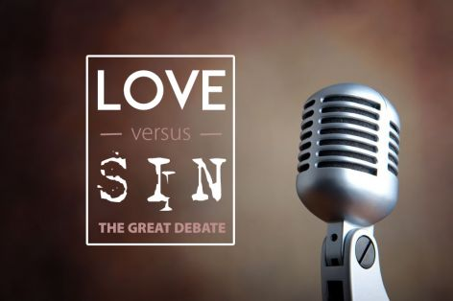

Slide 12


Slide 13
Whatever it takes, Lord, increase my capacity to love until I love you with all my heart, soul, strength, and mind, and love my neighbor as I love myself. Amen.

