Slide 1

21 Questions
to Christian Maturity

Slide 2

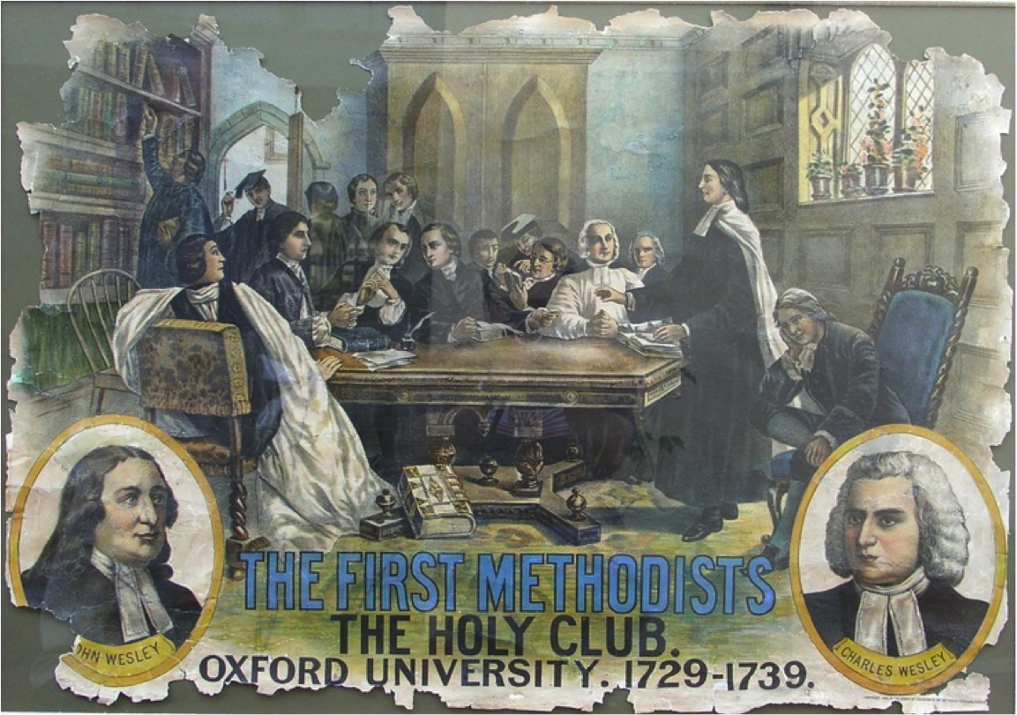

Slide 3
John Wesley's 21 questions for the Oxford Methodists
1. Is Jesus real to me?
2. Am I enjoying prayer?
3. Do I insist upon doing something about
which my conscience is uneasy?
4. Did the Bible live in me today?
5. Did I disobey God in anything?
6. Do I pray about the money I spend?
7. Do I give time for the Bible to speak
to me every day?

Slide 4
Is Jesus Real to Me?
1. The purpose of life is to RECEIVE, RECIPROCATE, and REFLECT God’s love.

Slide 5

Acts 17:26-28 (CEB)
²⁶ From one person God created every human nation to live on the whole earth, having determined their appointed times and the boundaries of their lands. ²⁷ God made the nations so they would seek Him, perhaps even reach out to Him and find Him. In fact, God isn’t far away from any of us. ²⁸ In God we live, move, and exist. As some of your own poets said, ‘We are His offspring.’

Slide 6
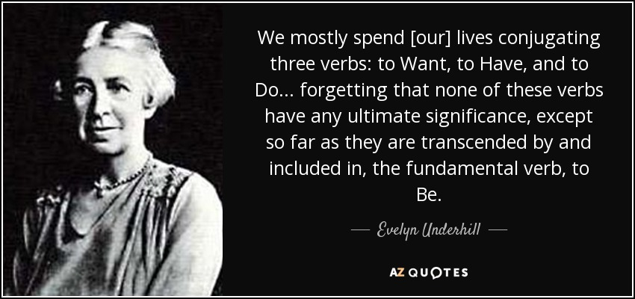

“So many Christians are like deaf people at a concert. They study the program carefully, believe every statement made in it, speak respectfully of the quality of the music, but only really hear a phrase now and again.”
~Evelyn Underhill

Slide 7
“So they have no notion at all of the mighty symphony which fills the universe, to which our lives are destined to make their tiny contribution, and which is the self-expression of the Eternal God.” ~Evelyn Underhill

Slide 8
“What is asked of us is not necessarily a great deal of time devoted to what we regard as spiritual things, but the constant offering of our wills to God, so that the practical duties which fill most of our days can become part of His order and be giving spiritual worth.”
~Evelyn Underhill

Slide 9
Is Jesus Real to Me?
2. Do everything as though Jesus is next to you
“So, whether you eat or drink or whatever you do, you should do it all for God’s glory.” ~1 Corinthians 10:31
“Whatever you do, whether in speech or action, do it all in the name of the Lord Jesus and give thanks to God the Father through Him.” ~Colossians 3:17

Slide 10
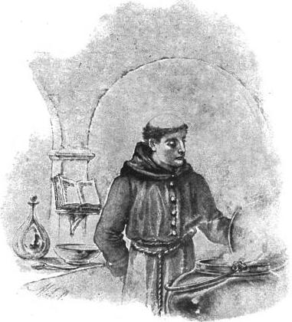

Slide 11
Is Jesus Real to Me?
3. Mindfulness - paying attention - seeing God all around you

Slide 12
St. Ignatius of Loyola: “Daily Prayer of Examen”
1. What are the blessings in my life? - Give thanks!
2. Where did I meet God or see God at work today? - Reflect.
3. What happened in my day? What did I learn, How did I feel? -Reflect.
4. Where did I fall short of God’s will today? - Confess. [You can do better.]
5. Offer tomorrow’s plans and myself to God.
- Petition.
6. Pray for the needs of others.
7. Close with the Lord’s Prayer
Use a journal!

Slide 13

Is Jesus Real to Me?

