Slide 1

O Foolish Christians
Rev. Dr. David Werner
“O Foolish Christians!” Galatians 4:11, “I am afraid that my work for you may have been wasted.”

Slide 2
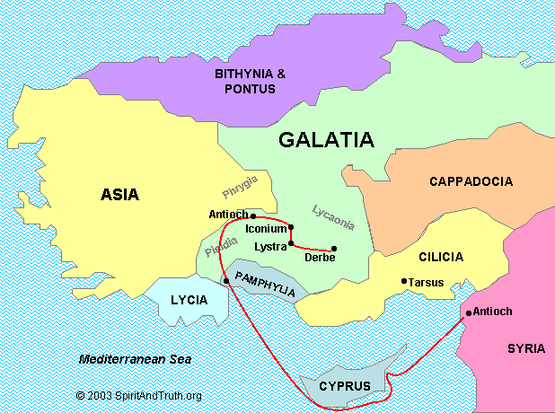
Present day Turkey

Slide 3


Slide 4
Galatians 4:1-11
¹ I’m saying that as long as the heirs are minors, they are no different from slaves, though they really are the owners of everything. ² However, they are placed under trustees and guardians until the date set by the parents. ³ In the same way, when we [Jews] were minors, we were also enslaved by stoichia [this world’s system].

Slide 5
Galatians 4:1-11
⁴ But when the fulfillment of the time came, God sent His Son, born through a woman, and born under the Law. ⁵ This was so He could redeem those under the Law [Jews] so that we could be adopted. ⁶ Because you [Christians] are sons and daughters, God sent the Spirit of His Son into our [Christians’] hearts, crying, “Abba, Father!”

Slide 6
Galatians 4:1-11
⁷ Therefore, you are no longer a slave but a son or daughter, and if you are His child, then you are also an heir through God. ⁸ At the time, when you didn’t know God, you were enslaved by stoichia [things that aren’t gods by nature]. ⁹ But now, after knowing God (or rather, being known by God), how can you turn back again to the weak and worthless world system? Do you want to be slaves to it again? ¹⁰ You observe religious days and months and seasons and years. ¹¹ I’m afraid for you! Perhaps my hard work for you has been for nothing.

Slide 7
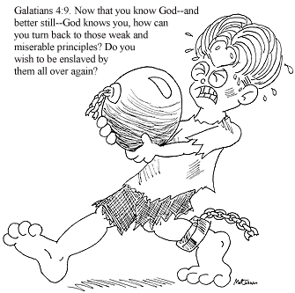

Slide 8



Slide 9


Slide 10



Slide 11
