Slide 1

“The smoke of the incense offered for the prayers of the saints rose up before God from the angel’s hand.”
~Revelation 8:4
“They Need Your Help.”

Slide 2

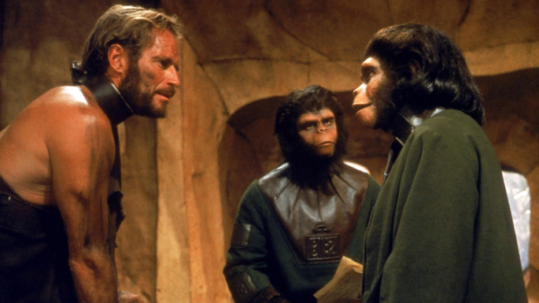

Slide 3
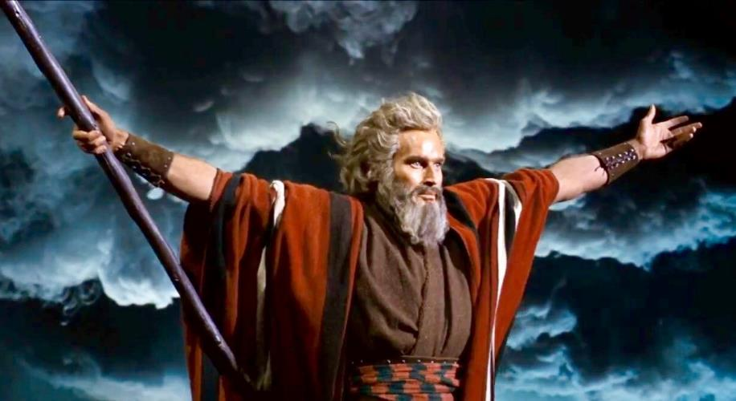

Slide 4


Biblical “Pocket Prayer” Outline:
Father,
    You are good.
    I need you.
    So do they.
    Thank you.
    Amen.

Slide 5
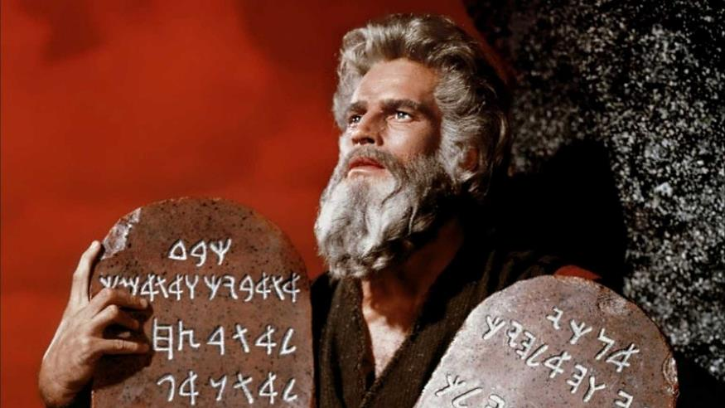

Slide 6
They Need Your Help.
Mission
It’s good to do
Luke 11:5-10 (The persistent neighbor)

Slide 7
They Need Your Help.
Mission
It’s good to do
Blessing
It’s good for them
2 Corinthians 5:20 (We are ambassadors to others)

Slide 8
They Need Your Help.
Mission
It’s good to do
Blessing
It’s good for them
Growth
It’s good for you
1 John 3:3 (We are purified when we pray)

Slide 9
They Need Your Help.
Mission
It’s good to do
Blessing
It’s good for them
Growth
It’s good for you
Effective
It makes a difference
James 5:16 (Prayers cause change)

Slide 10
Exodus 32:7-14 (CEB)
⁷ The Lord spoke to Moses: “Hurry up and go down! Your people, whom you brought up out of the land of Egypt, are ruining everything! ⁸ They’ve already abandoned the path that I commanded. They have made a metal bull calf for themselves. They’ve bowed down to it and offered sacrifices to it and declared, ‘These are your gods, Israel, who brought you up out of the land of Egypt!’” ⁹ The Lord said to Moses, “I’ve been watching these people, and I’ve seen how stubborn they are. ¹⁰ Now leave me alone! Let my fury burn and devour them. Then I’ll make a great nation out of you.”

Slide 11
Exodus 32:7-14 (CEB)
¹¹ But Moses pleaded with the Lord his God, “Lord, why does your fury burn against your own people, whom you brought out of the land of Egypt with great power and amazing force? ¹² Why should the Egyptians say, ‘He had an evil plan to take the people out and kill them in the mountains and so wipe them off the earth’? Calm down your fierce anger. Change your mind about doing terrible things to your own people.

Slide 12
Exodus 32:7-14 (CEB)
¹³ Remember Abraham, Isaac, and Israel, your servants, whom you yourself promised, ‘I’ll make your descendants as many as the stars in the sky. And I’ve promised to give your descendants this whole land to possess for all time.’” ¹⁴ Then the Lord changed His mind about the terrible things He said He would do to His people.

Slide 13
They Need Your Help.
Mission
It’s good to do
Blessing
It’s good for them
Growth
It’s good for you
Effective
It makes a difference

Slide 14
Biblical “Pocket Prayer” Outline:
Father,
    You are good.
    I need your help.
    Heal me.
    Forgive me.
    So do they.
  [Pause for personal prayers.]
    Thank you. Amen.

