Slide 1
“Cast your anxiety on Him every day, because you know how much He cares for you.” ~1 Peter 5:7
“I Need Your Help.
Heal Me. Forgive Me.”

Slide 2
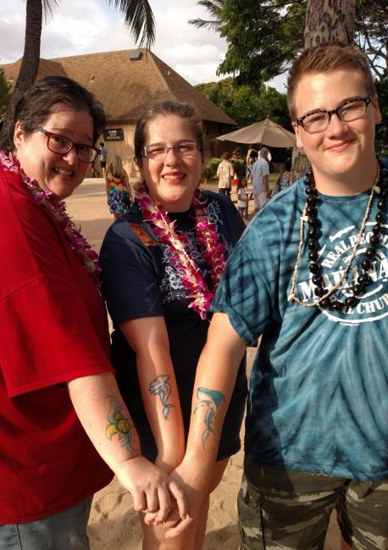

Slide 3
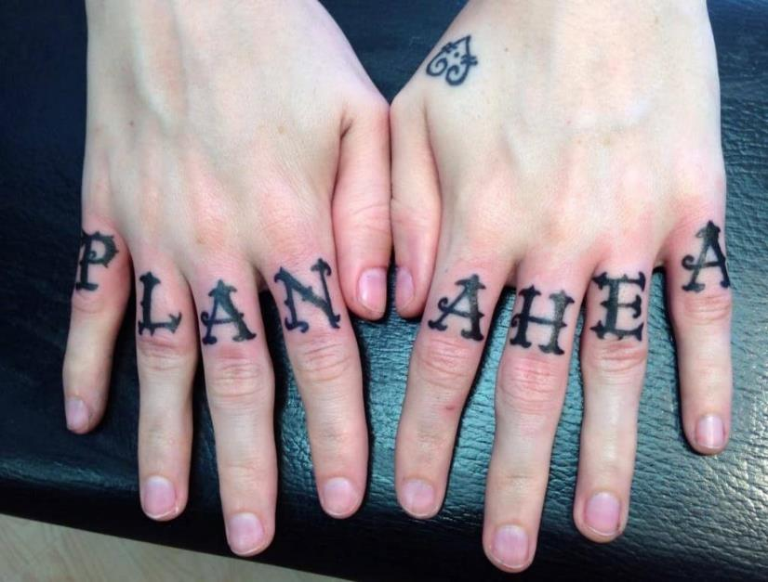

Slide 4
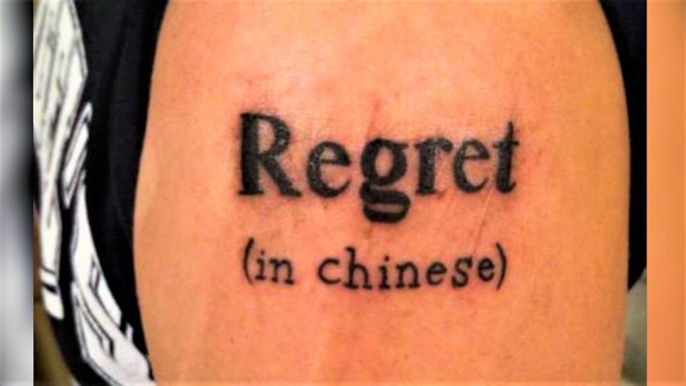

Slide 5
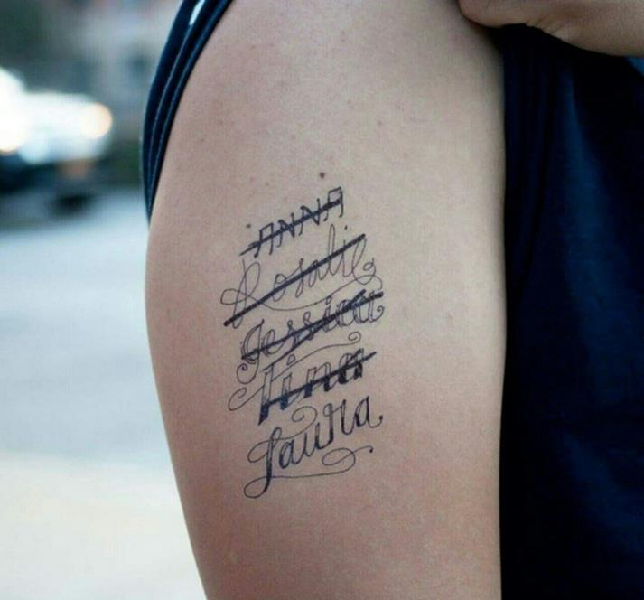

Slide 6
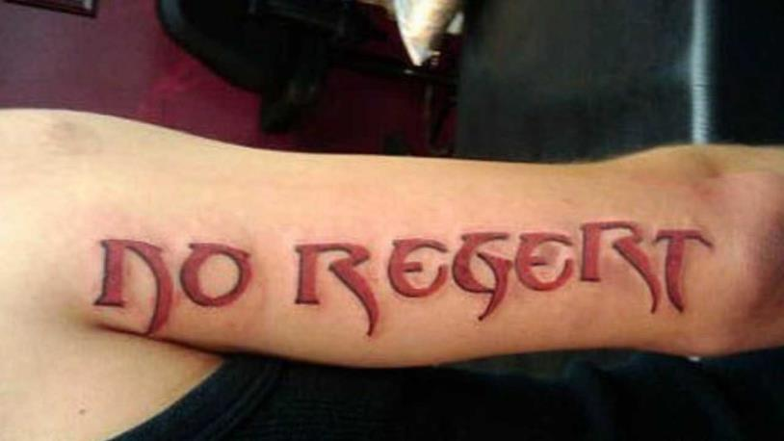

Slide 7
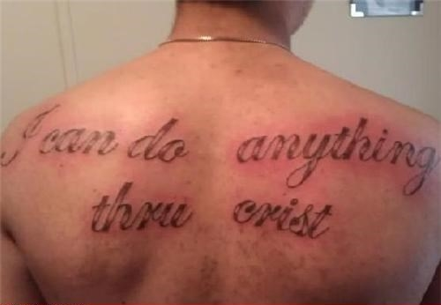

Slide 8
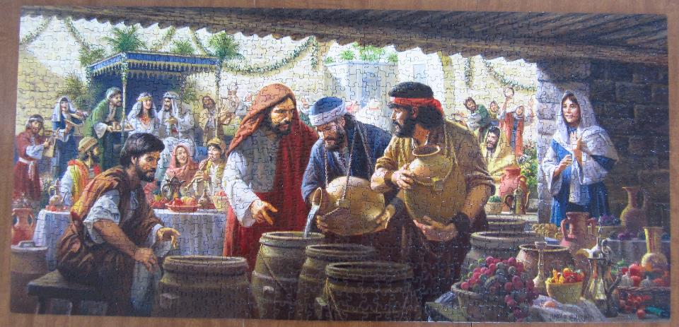

Slide 9
John 2 (CEB)
¹ On the third day there was a wedding in Cana of Galilee. Jesus’ mother was there, and ² Jesus and His disciples were also invited to the celebration. 3 When the wine ran out, Jesus’ mother said to Him, “They don’t have any wine.”
⁴ Jesus replied, “Woman, what does that have to do with me? My time hasn’t come yet.”
⁵ His mother told the servants, “Do whatever He tells you.”

Slide 10
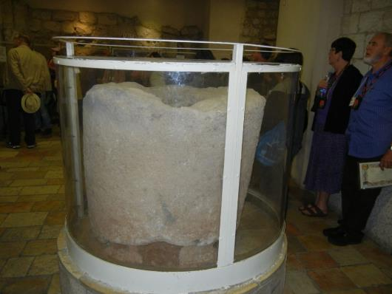
John 2 (CEB)
⁶ Nearby were six stone water jars used for the Jewish cleansing ritual, each able to hold about twenty or thirty gallons. ⁷ Jesus said to the servants, “Fill the jars with water,” and they filled them to the
brim. ⁸ Then He told
them, “Now draw
some from them
and take it to the
headwaiter,” and
they did.

Slide 11
John 2 (CEB)
⁹ The headwaiter tasted the water that had become wine. He didn't know where it came from, though the servants who had drawn the water knew. The headwaiter called the groom ¹⁰ and said, “Everyone serves the good wine first. They bring out the second rate wine only when the guests are drinking freely. You kept the good wine until now.”
¹¹ This was the first miraculous sign that Jesus did in Cana of Galilee. He revealed His glory, and His disciples believed in Him.

Slide 12
Biblical “Pocket Prayer” Outline:
Father,
You are good.
I need you.
So do they.
Thank you.
Amen.

Slide 13
“I need
your help.”

Slide 14
“I need your help.”
Take your problems to Jesus!

Slide 15
“I need your help.”
Heal me
Forgive me

Slide 16
“I need your help.”
Heal me

Slide 17


Slide 18
Biblical “Pocket Prayer” Outline:
Father,
You are good.
I need your help.
Heal me.
Forgive me.
[Pause for personal prayers.]
So do they.
Thank you.
Amen.

