Slide 1
If God is Love, How Can He Send People to Hell?

Slide 4
What does
Love
mean?

Slide 5
Love
A free and reciprocal choice.

Slide 8
send

Slide 9
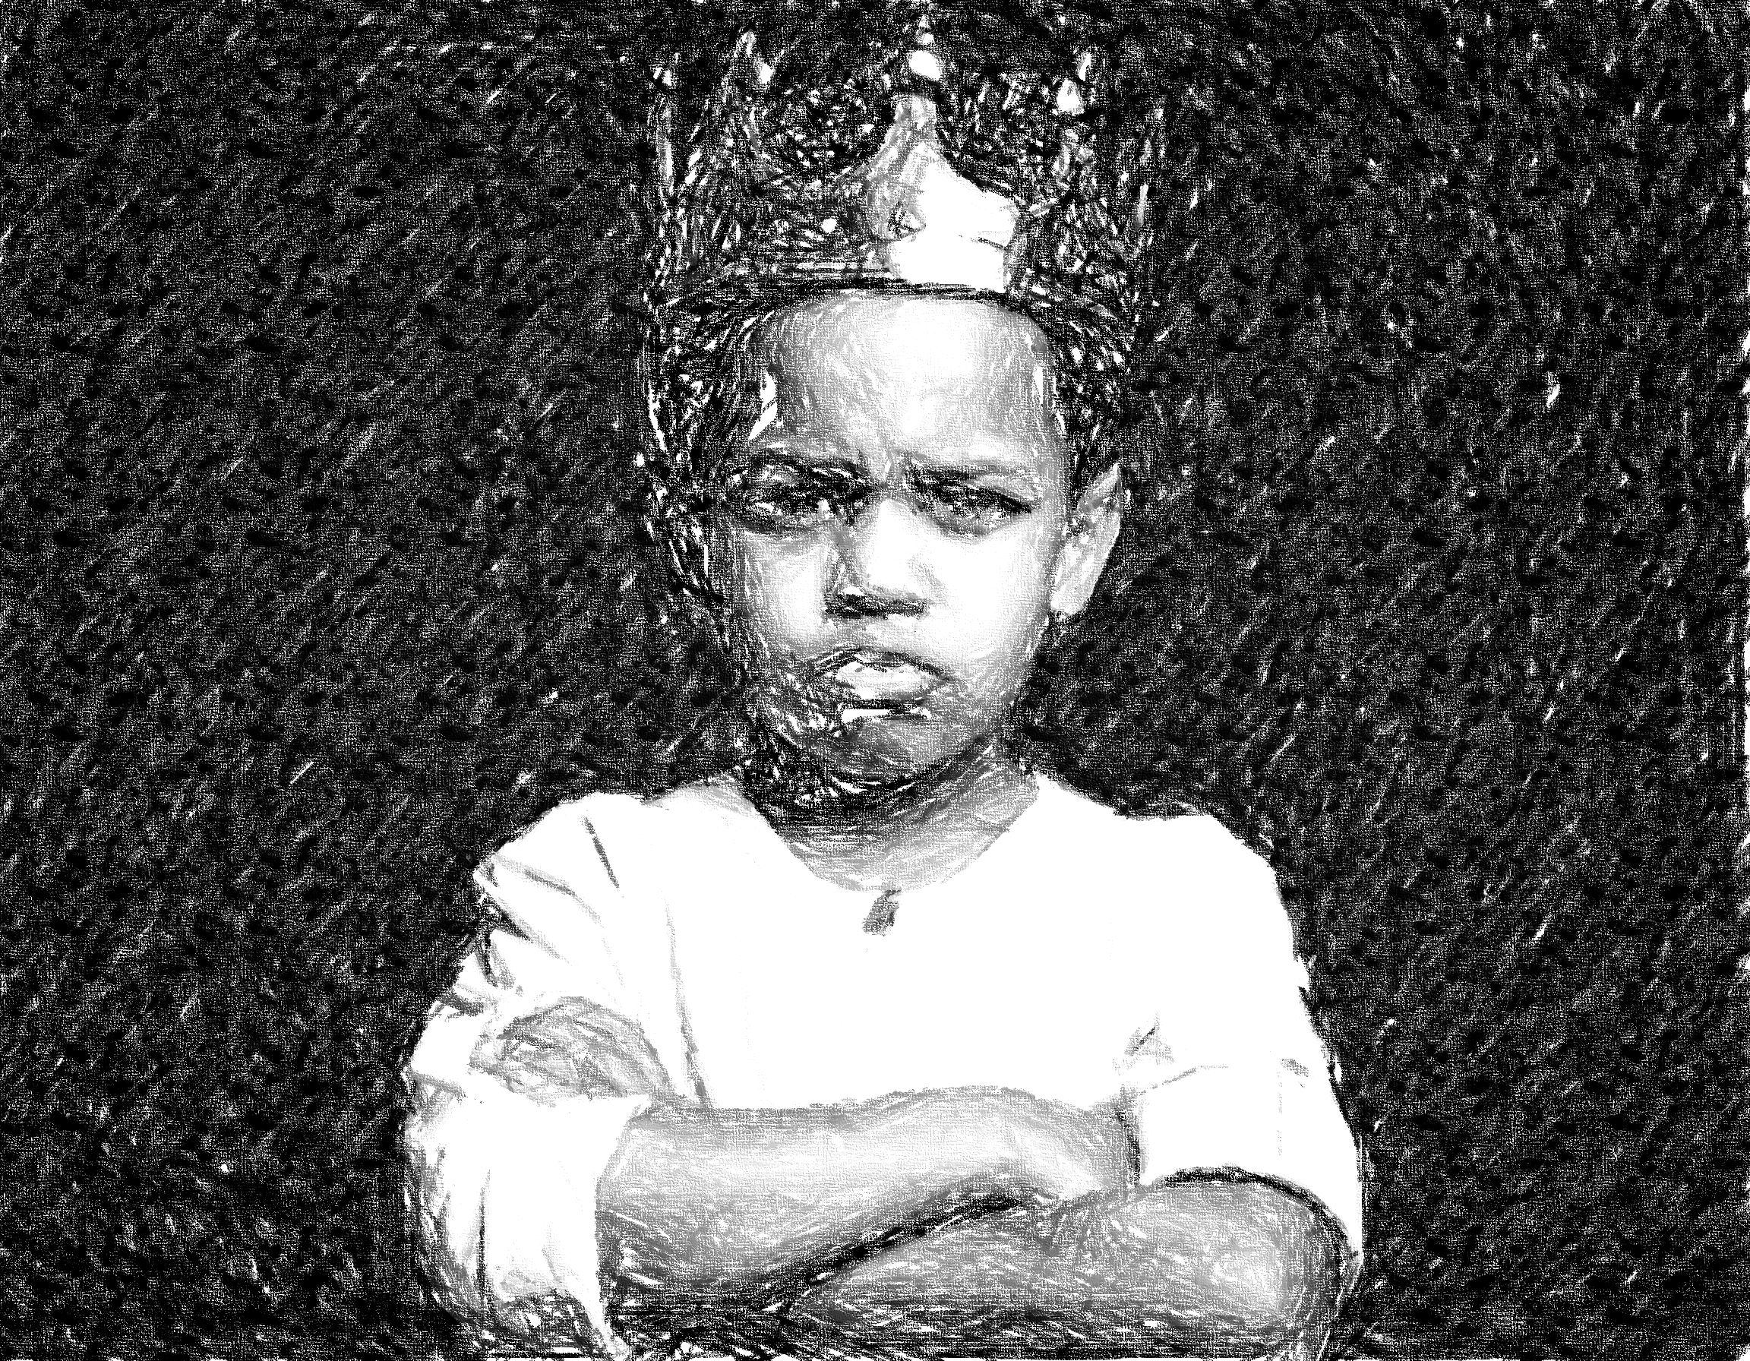

Slide 10
Suffering. Pain. Evil.

Slide 11
Suffering. Pain. Evil.

Slide 12
Matthew
8:12; 25:30; 10:28

Slide 13
righteous
Matthew
8:12; 25:30; 10:28
Unrighteous

Slide 14
“Get away from me! Go into the unending fire that has been prepared for the devil and his angels.”
Matthew
8:12; 25:30; 10:28

Slide 15
“There is no doctrine which I would more willingly remove from Christianity than this, if it lay in my power. But it has the full support of scripture and, specially, of Our Lord’s own words…I would pay any price to be able to say truthfully ‘All will be saved.’ But my reason retorts ‘Without their will, or with it?’”

