Slide 1



Slide 2
Play video

Slide 3
Sweetheart

Slide 4



Communication

Slide 5


  INTERCESSOR
  “Go-between”
^{Transactional}
^{Immediate}
^{Relational}
^{Slow Progress}

Slide 6
  INTERCESSOR
  “Go-between”
  Both sides
^{Transactional}
^{Immediate}
^{Relational}
^{Slow Progress}

Slide 7
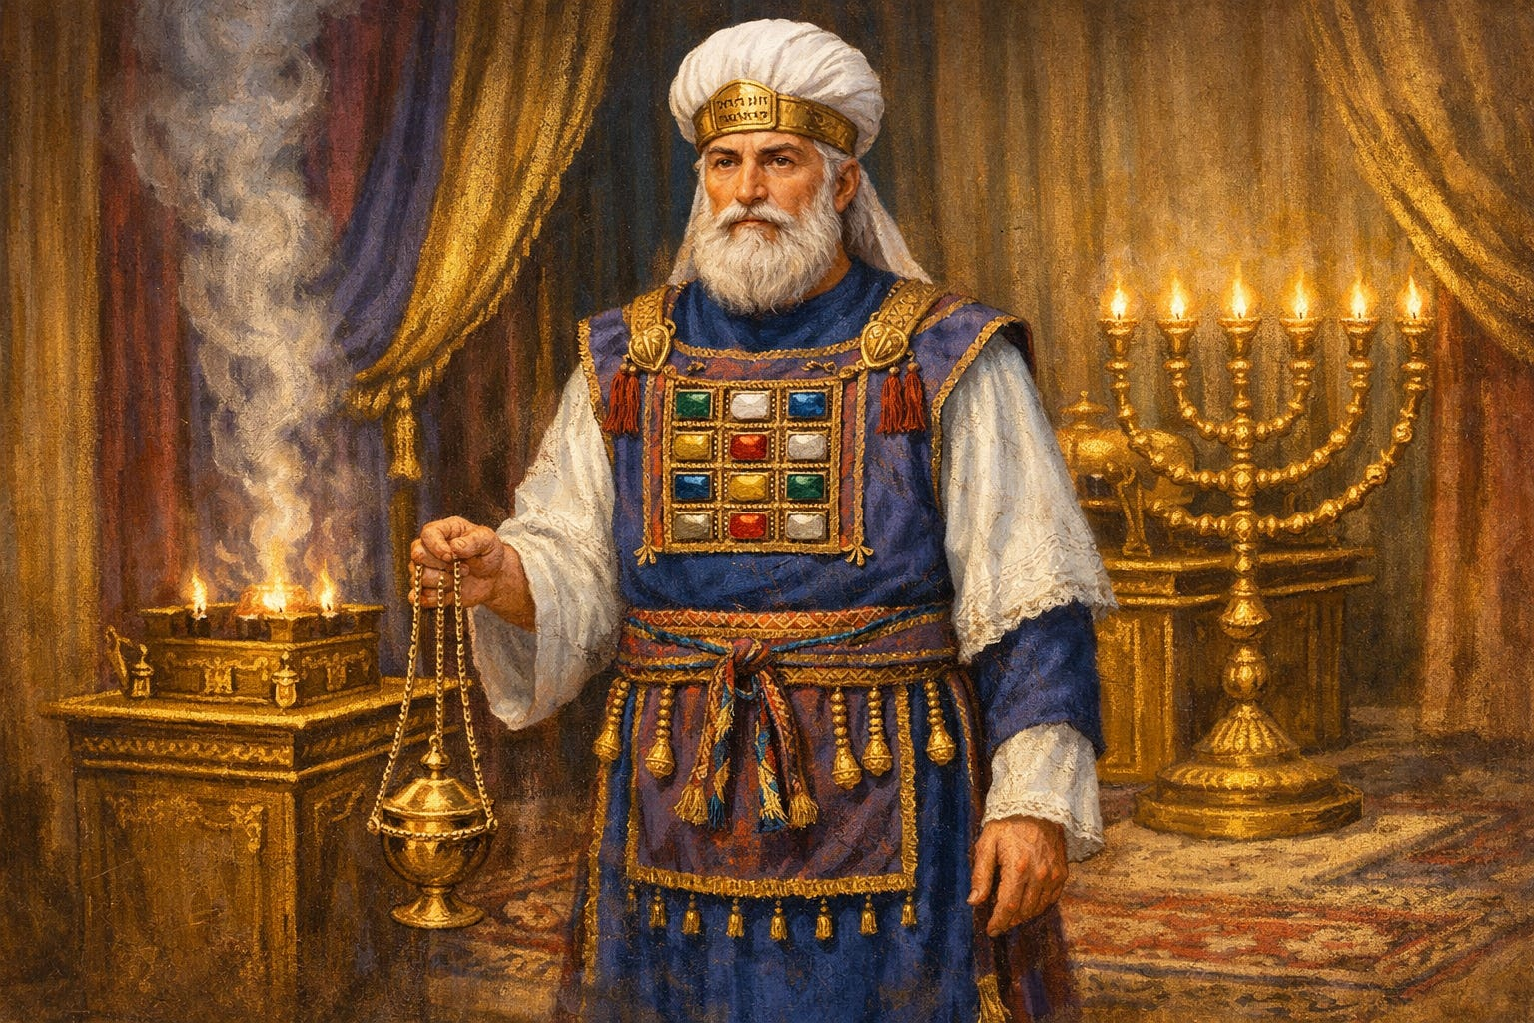

Slide 8
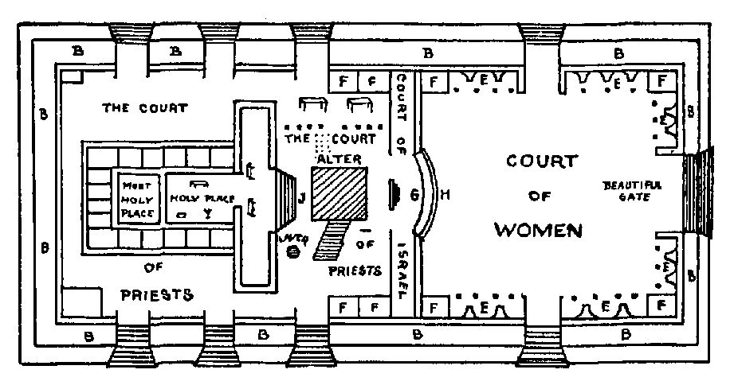

Slide 9
  EXCLUSIVE

Slide 10
  Holy
  “Pure, Perfect, Sinless”
  “Set Apart”
^{Transactional}
^{Immediate}
^{Relational}
^{Slow Progress}

Slide 11
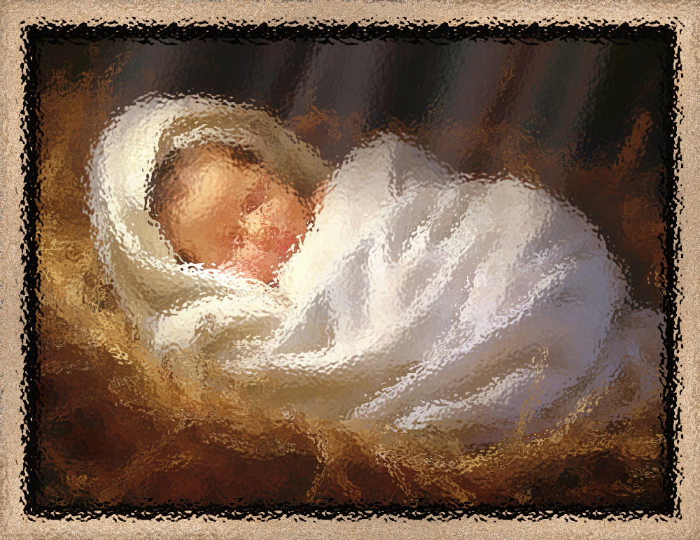

  Holy
  “Pure, Perfect, Sinless”
  “Set Apart”
^{Transactional}
^{Immediate}
^{Relational}
^{Slow Progress}

Slide 12

“We believe in one Lord, Jesus Christ, the only Son of God, eternally begotten of the Father, God from God, Light from Light, true God from true God, begotten not made, one in being with the Father.”

Slide 13
  “Who will bring a charge against God’s elect people? It is God who acquits them. Who is going to convict them? It is Jesus Christ who died, even more, who was raised, and who also is at God’s right side. It is Christ Jesus who also pleads our case for us.”
^{Transactional}
^{Immediate}
^{Relational}
^{Slow Progress}

Slide 14
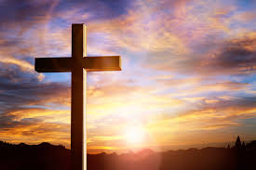

Slide 15
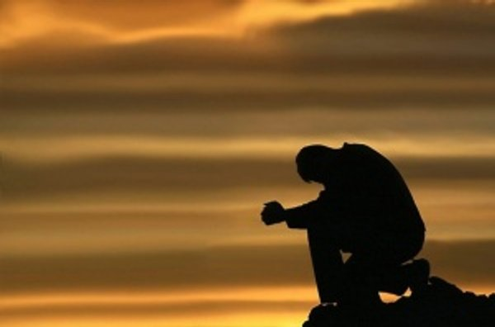
  Do not despair in unanswered prayer, maintain your voice and rejoice!
Prayer

Slide 16


Slide 17


Slide 18

  INTERCESSOR
  “Go-between”
  Both sides
^{Transactional}
^{Immediate}
^{Relational}
^{Slow Progress}

Slide 19

Insert Video

